Slide 1



CHOOSE YOUR PROFILE
PSYCHFLIX
Film
TV shows
Books
Notes:
The links have already been set up on this template but to set it up you:
Right click the icons (pictures inserted)
Press link
Click the place in this document option
Choose the slide to link to

Slide 2































PSYCHFLIX Films
Browse
Search
Trending Now
Top Picks for You
Favourites

Slide 3









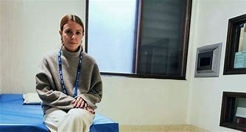


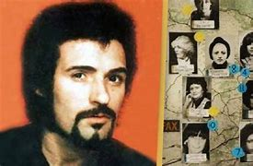














PSYCHFLIX TV
Browse
Search
Trending Now
Top Picks for You
Favourites

Slide 4

































PSYCHFLIX Books
Browse
Search
Trending Now
Top Picks for You
Favourites

