Slide 1

Quick task: Shortlisting UK universities

Slide 2

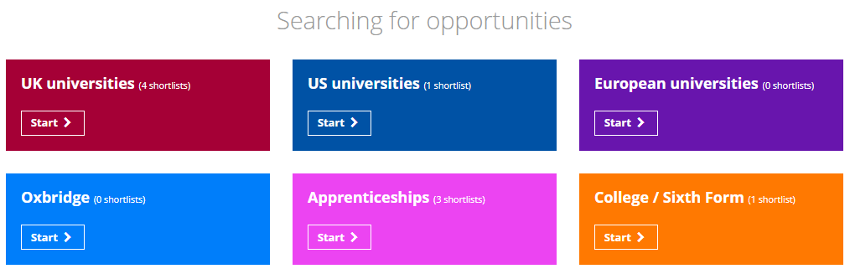

Using the Unifrog UK universities tool
The next few slides will show you how to use the UK universities tool.
After logging into your Unifrog account, scroll down to ‘Searching for opportunities.’
Click ‘Start’ on the ‘UK universities’ tile.
Notes:
Teacher’s notes:
The next few slides will teach students how to navigate the platform to use the UK universities tool.
Ask students to log into their Unifrog accounts and open the UK universities tool. You can demonstrate this on a smart board by clicking Student side>UK universities.

Slide 3
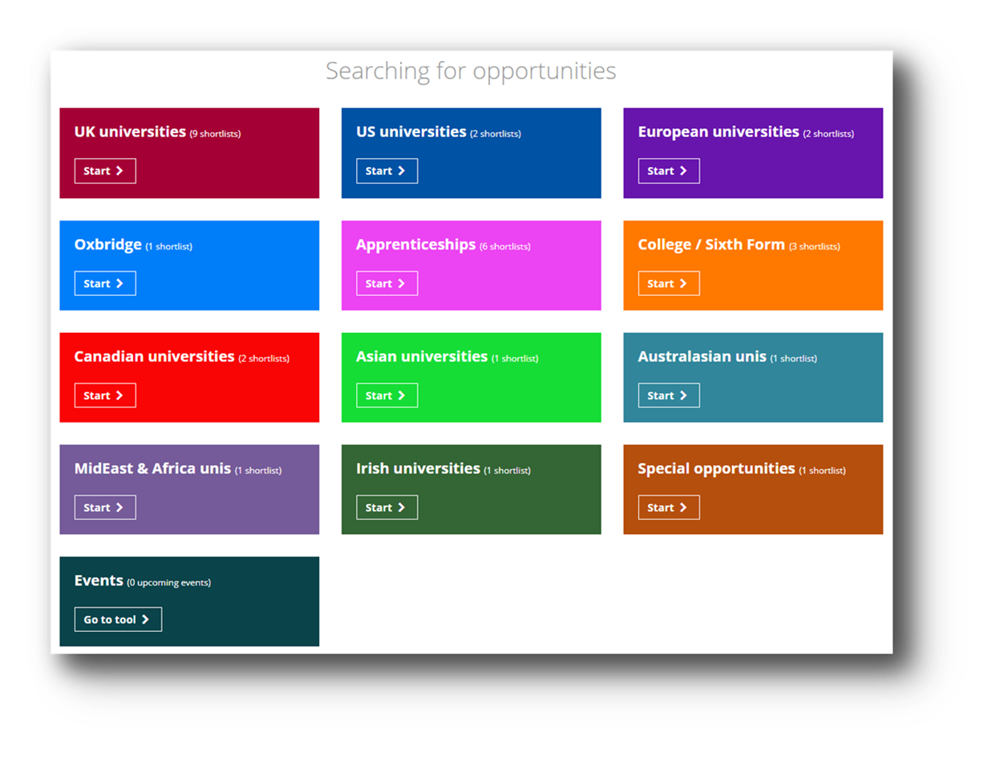

Using the Unifrog UK universities tool
You can use the UK universities tool to browse universities in the UK.
The other shortlisting tools will help you to browse other pathways.
Notes:
Teacher’s notes:
The next few slides will teach students how to navigate the platform to use the UK universities tool.
Unifrog has numerous other shortlisting tools, if students are interested in a pathway that is not a UK university.

Slide 4
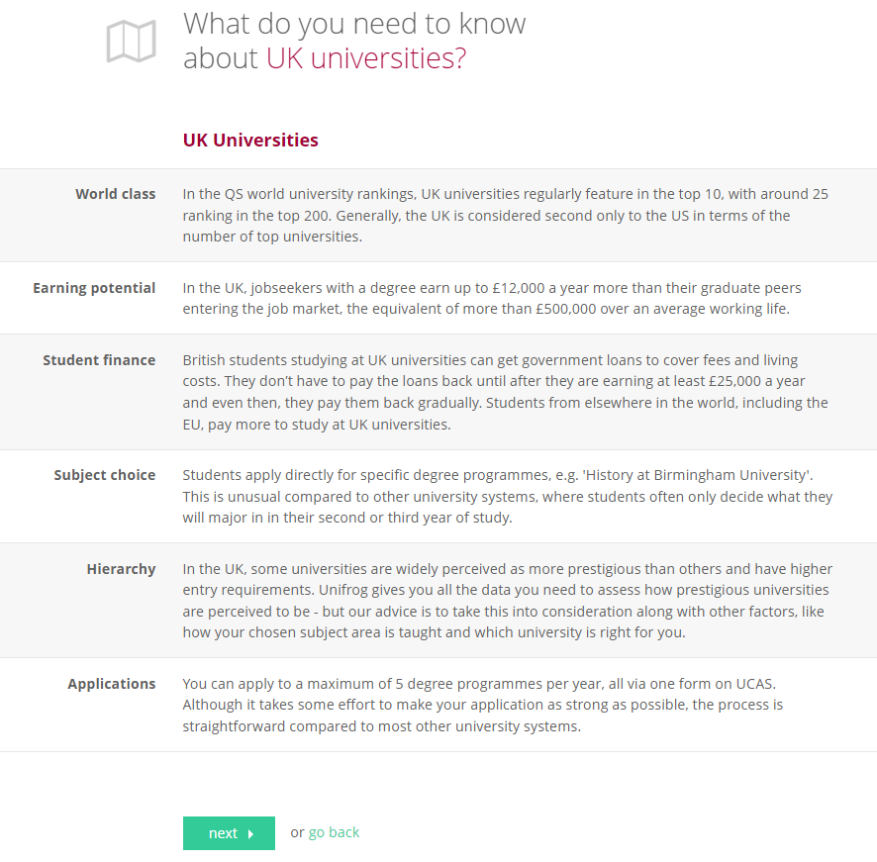
Using the Unifrog UK universities tool
You’ll see some information about UK universities to read first.
To get started with your search, click ‘next.’
Notes:
Teacher’s notes:
The next few slides will teach students how to navigate the platform to use the UK universities tool.
Students can read information about UK universities, under the following headings:
World class
Earning potential
Sweet deal
Applications
Hierarchy
UCAS
Students are to click ‘next’ to begin their search.

Slide 5
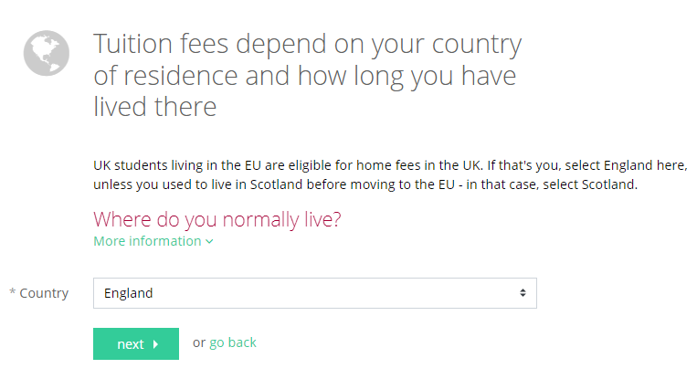

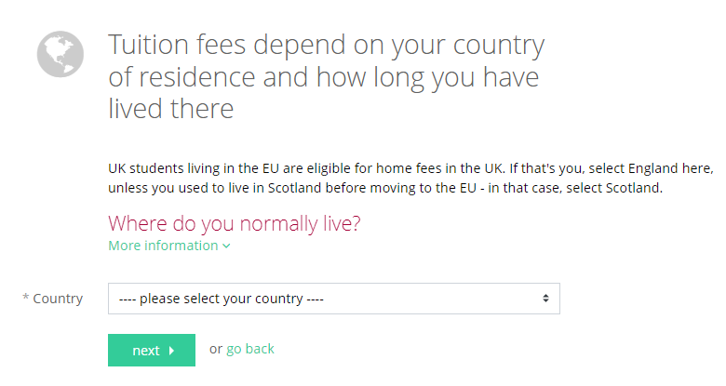
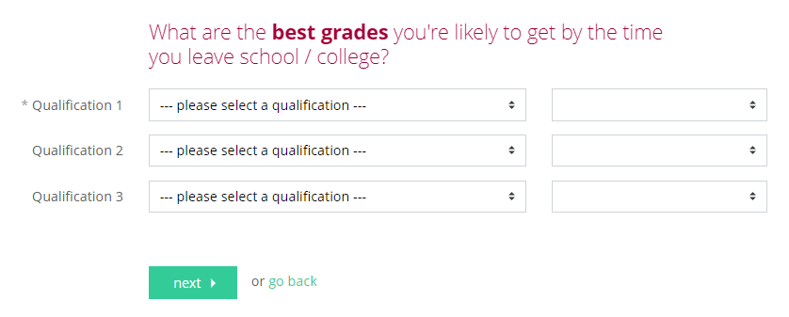
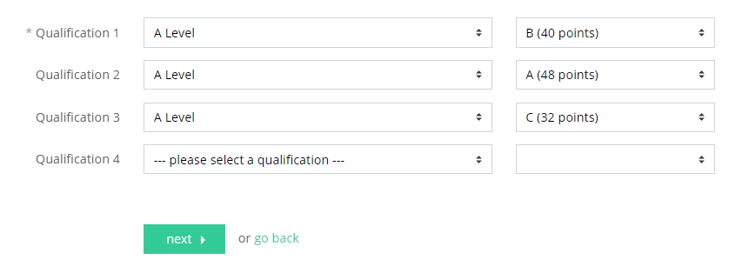

Using the Unifrog UK universities tool
Select your country of residence.
Then enter your best predicted grades.
Notes:
Teacher’s notes:
The next few slides will teach students how to navigate the platform to use the UK universities tool.
Students are to select their country of residence from the dropdown list.
Students are to select the best grades they’ll likely to achieve by the end of school/college from the dropdown lists of qualifications and grades, e.g. A Level: B, IB HL Subject: 6, BTEC Extended Certificate: M, etc.

Slide 6
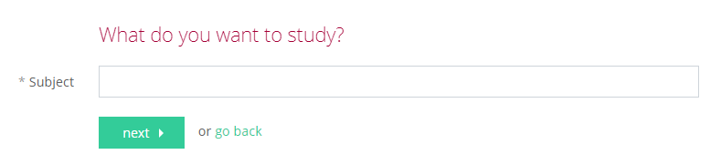
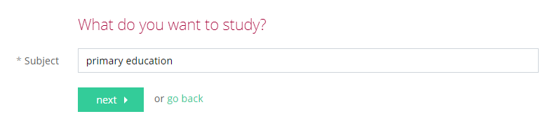

Using the Unifrog UK universities tool
Enter the subject you’d like to study at university and click ‘next’.
Notes:
Teacher’s notes:
The next few slides will teach students how to navigate the platform to use the UK universities tool.
Students are to enter the subject they’d like to study at university.
Students can create multiple shortlists, so they can repeat the process for different subjects if they’re still deciding what to study at university.

Slide 7
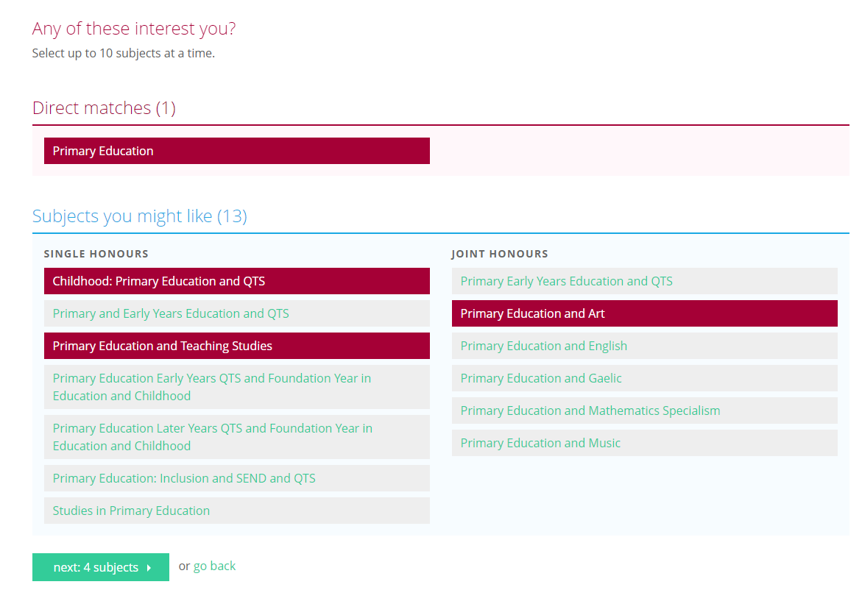
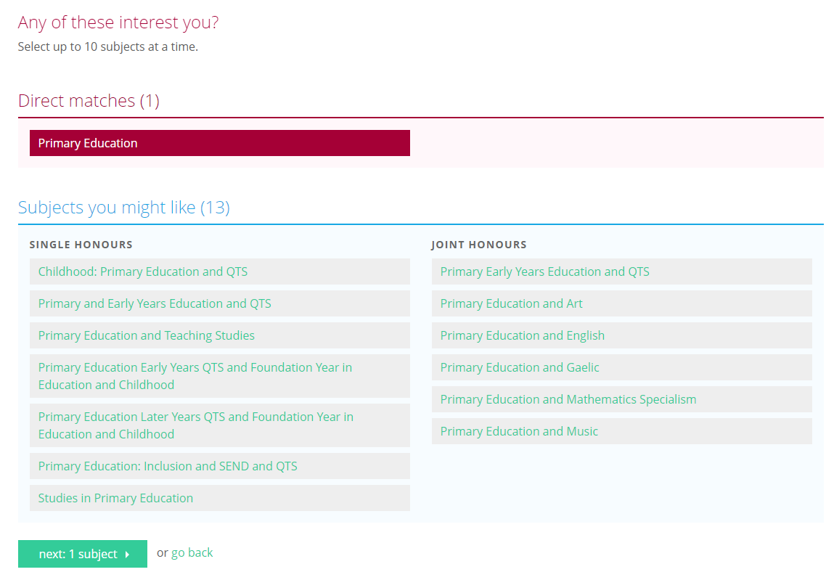
Using the Unifrog UK universities tool
Select up to 10 of the suggested subjects and click ‘next: X subjects’ to create your longlist.
Notes:
Teacher’s notes:
The next few slides will teach students how to navigate the platform to use the UK universities tool.
Students are to select up to 10 university subjects (single and/or joint honours), before clicking ‘next: X subjects.’
Students can create multiple shortlists, so they can repeat the process for different subjects if they’re still deciding what to study at university.

Slide 8
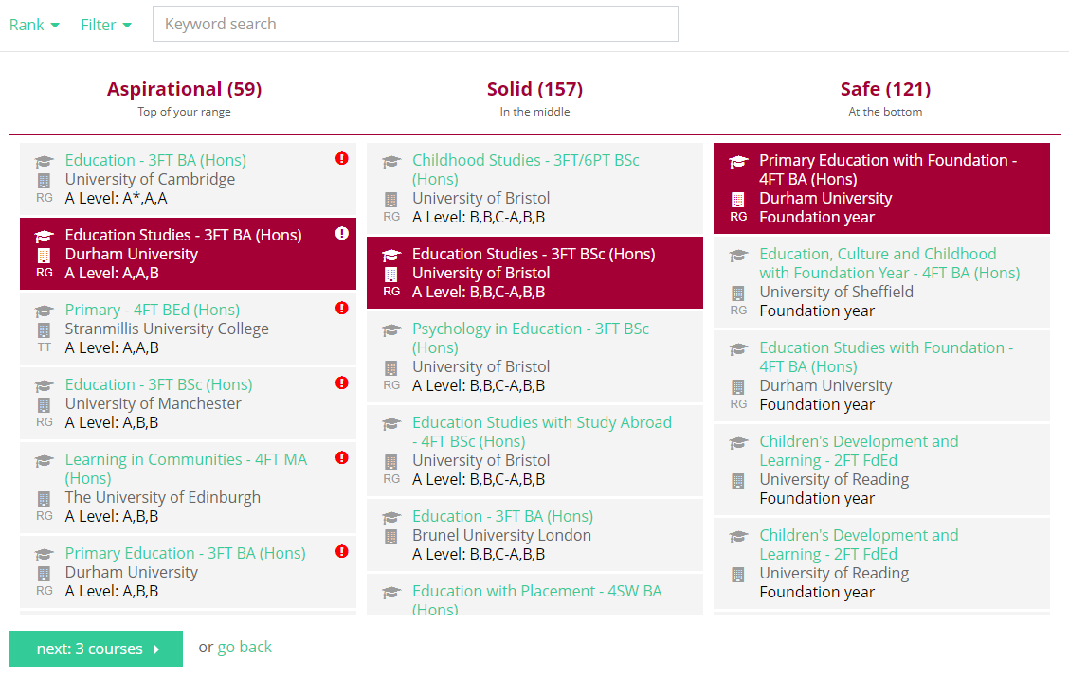
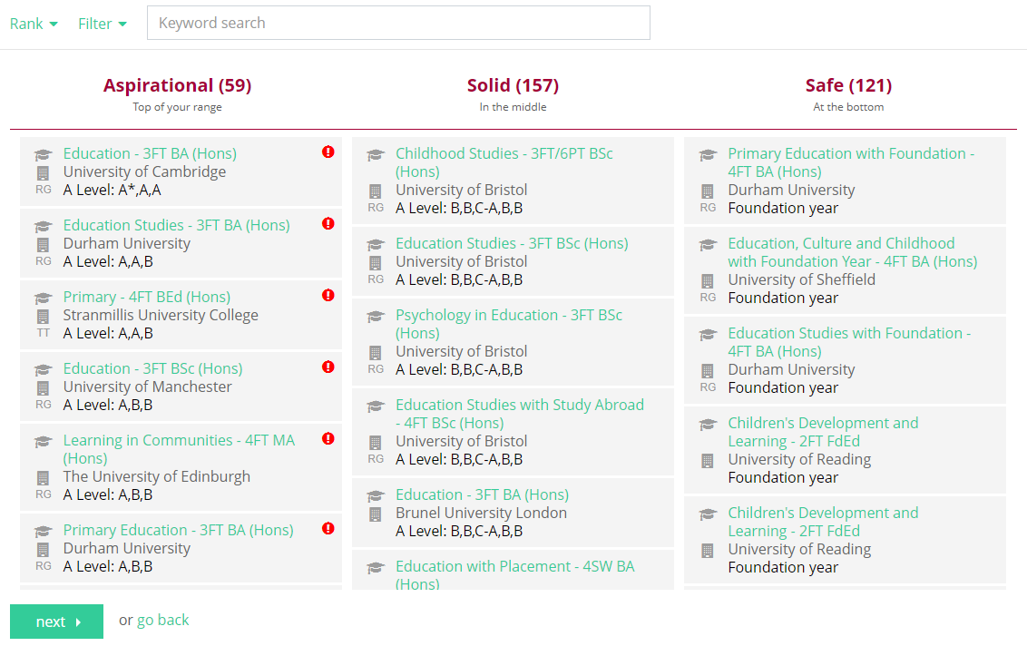

Using the Unifrog UK universities tool
Your longlist will be divided into three columns:
Aspirational
Solid
Safe
You might find it helpful to select at least one course in each column, to keep your options open no matter what grades you achieve.
Notes:
Teacher’s notes:
The next few slides will teach students how to navigate the platform to use the UK universities tool.
At the top of the page, students can click ‘glossary’ to see definitions of terminology relating to UK universities.
Students will see their longlist organised into three categories:
Aspirational
Solid
Safe
Students can filter their longlist by:
Keyword search
Distance
Mode (e.g. full time, sandwich, etc.)
Type (e.g. Russell Group, Joint Honours, etc.)
Difficulty
Relevance
Students can rank their longlist by several different criteria, such as entry requirements, average points, fees, rent, salary, etc.
Students can select up to 15 courses to include in their final shortlist. You may wish to remind students that they can create and save multiple shortlists.

Slide 9
Using the Unifrog UK universities tool
Remember to use the ranks and filters to refine your longlist, so that you can review the courses that are most relevant to you.
Notes:
Teacher’s notes:
The next few slides will teach students how to navigate the platform to use the UK universities tool.
At the top of the page, students can click ‘glossary’ to see definitions of terminology relating to UK universities.
Students will see their longlist organised into three categories:
Aspirational
Solid
Safe
Students can filter their longlist by:
Keyword search
Distance
Mode (e.g. full time, sandwich, etc.)
Type (e.g. Russell Group, Joint Honours, etc.)
Difficulty
Relevance
Students can rank their longlist by several different criteria, such as entry requirements, average points, fees, rent, salary, etc.
Students can select up to 15 courses to include in their final shortlist. You may wish to remind students that they can create and save multiple shortlists.

Slide 10
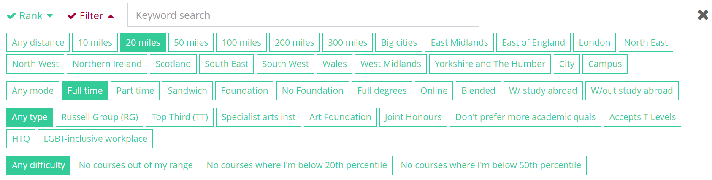
Using the Unifrog UK universities tool
e.g. you might want to filter to only show courses within 20 miles that are full time.
Notes:
Teacher’s notes:
The next few slides will teach students how to navigate the platform to use the UK universities tool.
At the top of the page, students can click ‘glossary’ to see definitions of terminology relating to UK universities.
Students will see their longlist organised into three categories:
Aspirational
Solid
Safe
Students can filter their longlist by:
Keyword search
Distance
Mode (e.g. full time, sandwich, etc.)
Type (e.g. Russell Group, Joint Honours, etc.)
Difficulty
Relevance
Students can rank their longlist by several different criteria, such as entry requirements, average points, fees, rent, salary, etc.
Students can select up to 15 courses to include in their final shortlist. You may wish to remind students that they can create and save multiple shortlists.

Slide 11
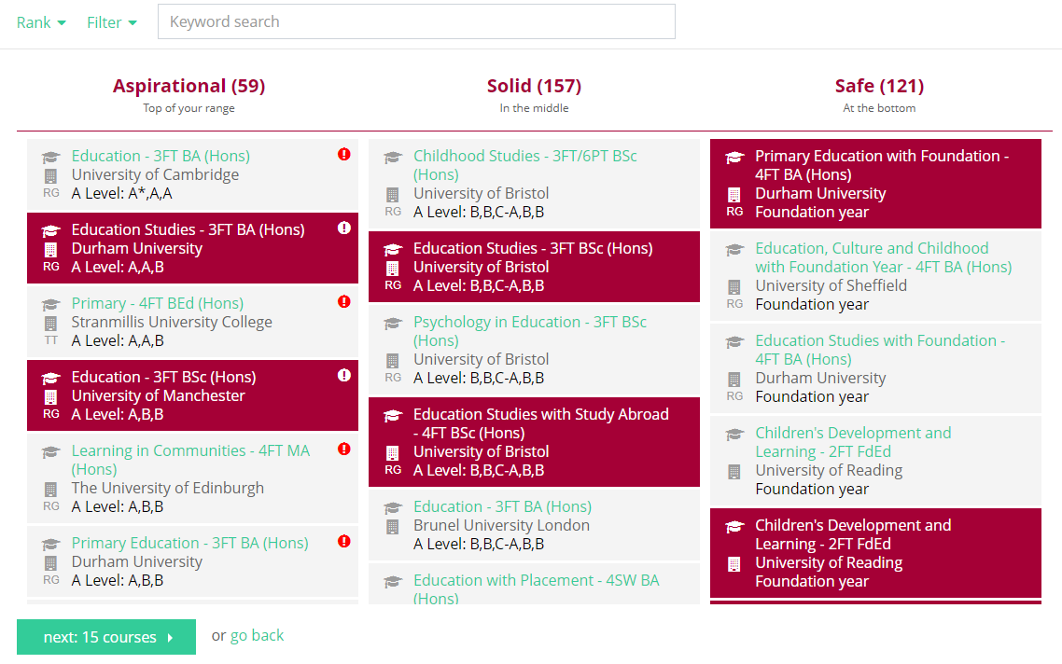
Using the Unifrog UK universities tool
Once you’ve selected the courses that interest you, click ‘next: X courses.’
Notes:
Teacher’s notes:
The next few slides will teach students how to navigate the platform to use the UK universities tool.
At the top of the page, students can click ‘glossary’ to see definitions of terminology relating to UK universities.
Students will see their longlist organised into three categories:
Aspirational
Solid
Safe
Students can filter their longlist by:
Keyword search
Distance
Mode (e.g. full time, sandwich, etc.)
Type (e.g. Russell Group, Joint Honours, etc.)
Difficulty
Relevance
Students can rank their longlist by several different criteria, such as entry requirements, average points, fees, rent, salary, etc.
Students can select up to 15 courses to include in their final shortlist. You may wish to remind students that they can create and save multiple shortlists.

Slide 12
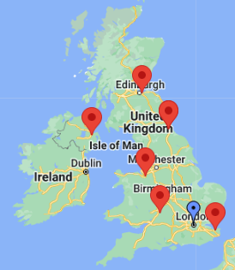


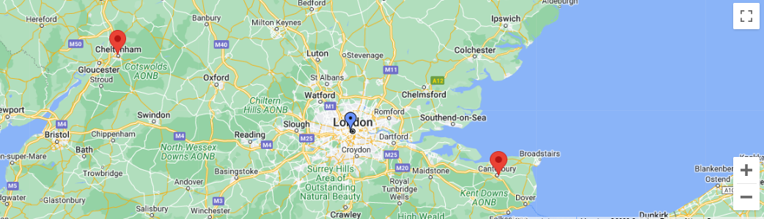
Using the Unifrog UK universities tool
At the top of your shortlist, you’ll see a map of the UK universities you’ve selected.
Click the + symbol to zoom in, to see exact locations.
Notes:
Teacher’s notes:
The next few slides will teach students how to navigate the platform to use the UK universities tool.
At the top of their shortlist, students will see an interactive map of their selected universities.

Slide 13


Using the Unifrog UK universities tool
In your shortlist, you’ll see more information about each university course, including links and videos.
Notes:
Teacher’s notes:
The next few slides will teach students how to navigate the platform to use the UK universities tool.
In their shortlist, students will be able to read:
Links to further information
Course facts
Upcoming events
University facts (including a video)
Getting in
If they are no longer interested in a course, students can click ‘delete’ to remove the course from the shortlist.

Slide 14
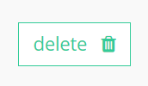
Using the Unifrog UK universities tool
If you’ve changed your mind about any courses, you can click ‘delete’ to remove them from your shortlist.
When you’re ready, click ‘save’ to finalise your shortlist of up to 15 university courses.
Notes:
Teacher’s notes:
The next few slides will teach students how to navigate the platform to use the UK universities tool.
If they are no longer interested in a course, students can click ‘delete’ to remove the course from the shortlist.
Students can select up to 15 courses to include in their final shortlist. You may wish to remind students that they can create and save multiple shortlists.
Students are to click ‘save’ to finalise their shortlist.
If students do not click ‘save’ then they will not be able to come back to their shortlist.

Slide 15

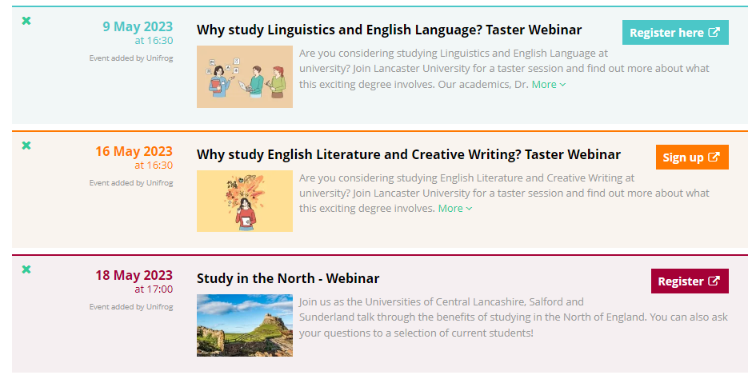
Using the Unifrog UK universities tool
It’s really important to save your shortlist!
Your shortlist doesn’t commit you to making an application. You can also make multiple shortlists. So don’t worry if you haven’t decided on a specific university or course yet!
Saving your shortlist means you’ll see the most relevant opportunities for you on your Unifrog homepage, like upcoming webinars.
Notes:
Teacher’s notes:
The next few slides will teach students how to navigate the platform to use the UK universities tool.
Students are to click ‘save’ to finalise their shortlist.
If students do not click ‘save’ then they will not be able to come back to their shortlist.

Slide 16
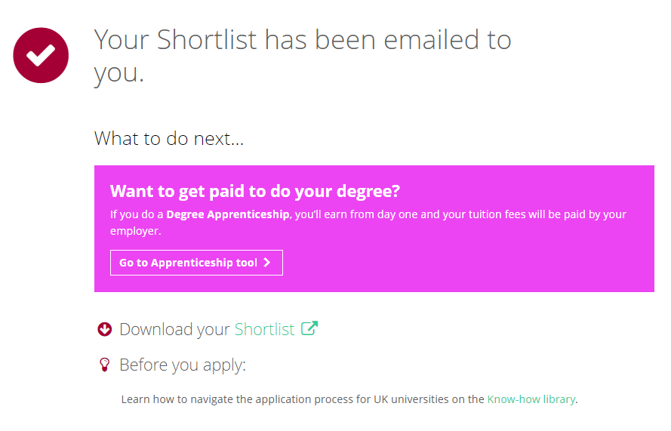
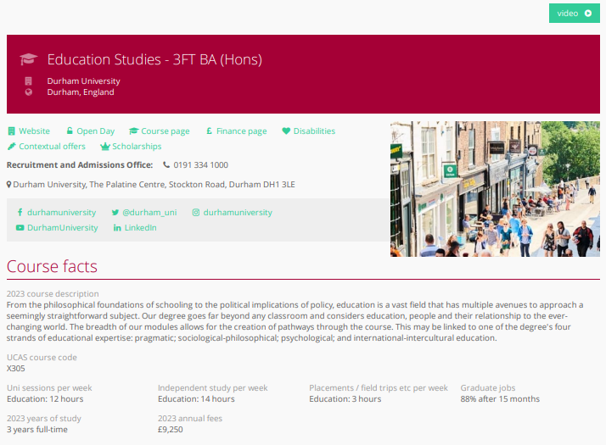
Using the Unifrog UK universities tool
When viewing your shortlist, you can click the links to go to the university’s website.
Notes:
Teacher’s notes:
The next few slides will teach students how to navigate the platform to use the UK universities tool.
Students can access their shortlist:
By clicking ‘shortlist’ on this screen
By email
By clicking Favourites > Search tools > Filter by: UK Uni
Tracking students’ progress:
You can track student progress with creating UK university shortlists by clicking Advanced>Sort by>UK uni shortlists.
From your homepage, you can also create charts showing shortlists that have been made. Go to Usage charts you can customise>UK pathways shortlisting / UK aspirational shortlisting.

Slide 17
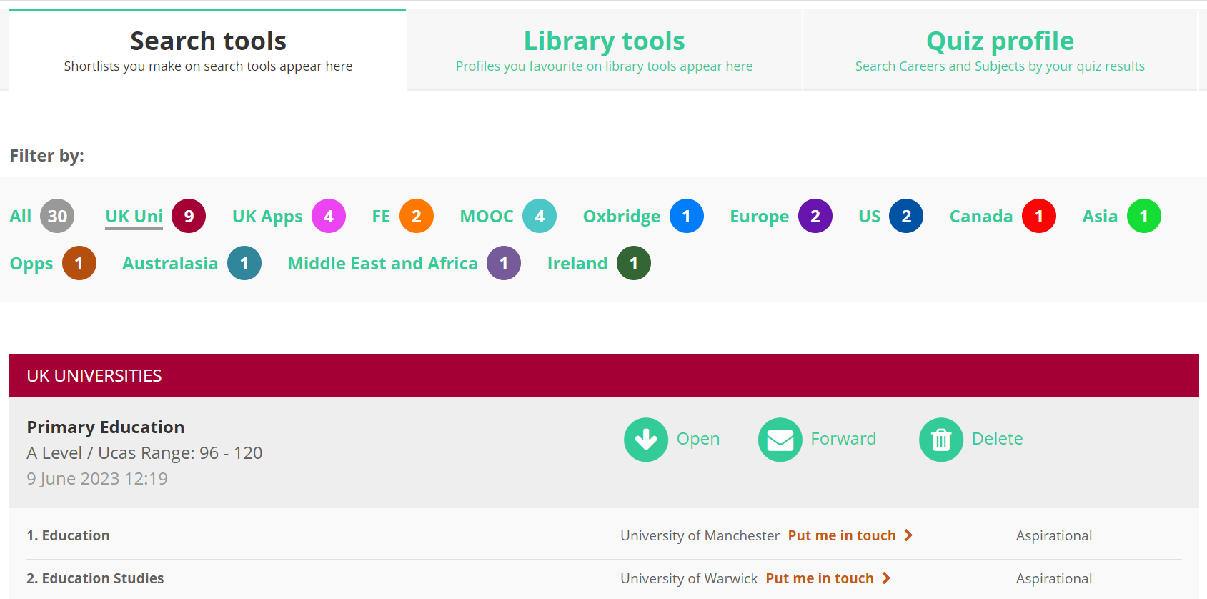

Using the Unifrog UK universities tool
Here, you can click ‘Put me in touch’ to contact the university directly.
You can find your shortlist again in the future by clicking Favourites at the top of your homepage.
Notes:
Teacher’s notes:
The next few slides will teach students how to navigate the platform to use the UK universities tool.
Students can access their shortlist:
By clicking ‘shortlist’ on this screen
By email
By clicking Favourites > Search tools > Filter by: UK Uni
Tracking students’ progress:
You can track student progress with creating UK university shortlists by clicking Advanced>Sort by>UK uni shortlists.
From your homepage, you can also create charts showing shortlists that have been made. Go to Usage charts you can customise>UK pathways shortlisting / UK aspirational shortlisting.

Slide 18

Creating a UK university shortlist
Now it’s your turn to create a shortlist!
Select up to 10 subjects
What would you like to study at university?
Browse your longlist
Select up to 15 courses
Save your shortlist
Notes:
Teacher’s notes:
Following the instructions in the last few slides, students will be able to create a UK universities shortlist (Student side>UK universities).
Remind students to click ‘save’ when they have finalised their shortlist. This will enable them to revisit the shortlist in the future and access links to the university websites.
Tracking students’ progress:
You can track student progress with creating UK university shortlists by clicking Advanced>Sort by>UK uni shortlists.
From your homepage, you can also create charts showing shortlists that have been made. Go to Usage charts you can customise>UK pathways shortlisting / UK aspirational shortlisting.

Slide 19


