Slide 1

Quick task:
Recording your post 18 intentions

Slide 2

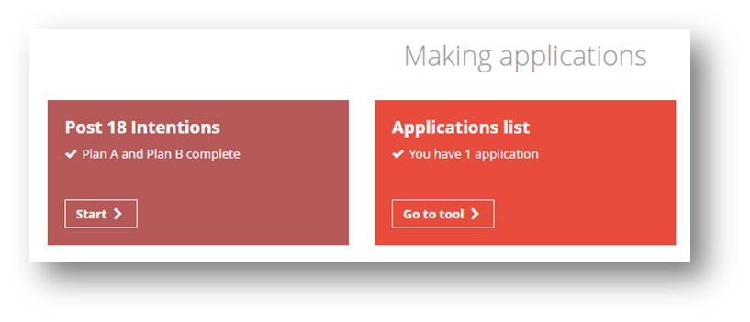

Using the Unifrog Post 18 intentions tool
The next few slides will show you how to use the Post 18 intentions tool.
After logging into your Unifrog account, scroll down to ‘Making applications.’
Click ‘Start’ on the ‘Post 18 Intentions’ tile.
Notes:
Teacher’s notes:
The next few slides will teach students how to navigate the platform to use the Post 18 Intentions tool.
The Post 18 Intentions tool is accessible for students in Year 12 / Grade 11 or above. Students in Year 11 / Grade 10 or below will see the ‘Post 16 Intentions’ tool instead. There is a separate PowerPoint which can be used with students in Year 11 / Grade 10 or below: Quick task: Recording your post 16 intentions.
Ask students to log into their Unifrog accounts and open the Post 18 Intentions tool. You can demonstrate this on a smart board by clicking Student side>Post 18 Intentions.

Slide 3
Using the Unifrog Post 18 intentions tool
What do you plan to do after college/sixth form?
UK University
Apprenticeship
FE Course
Job
Non-UK University
Other
I don’t know
Notes:
Teacher’s notes:
The next few slides will teach students how to navigate the platform to use the Post 18 Intentions tool.
When using the Post 18 Intentions tool, students can select from the following pathways:
UK University
Apprenticeship
FE Course
Job
Non-UK University
Other
I don’t know

Slide 4
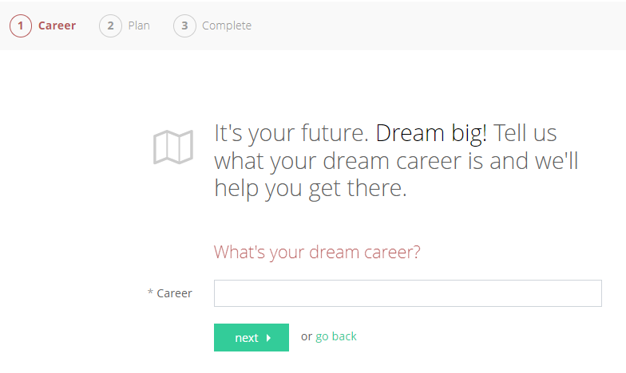


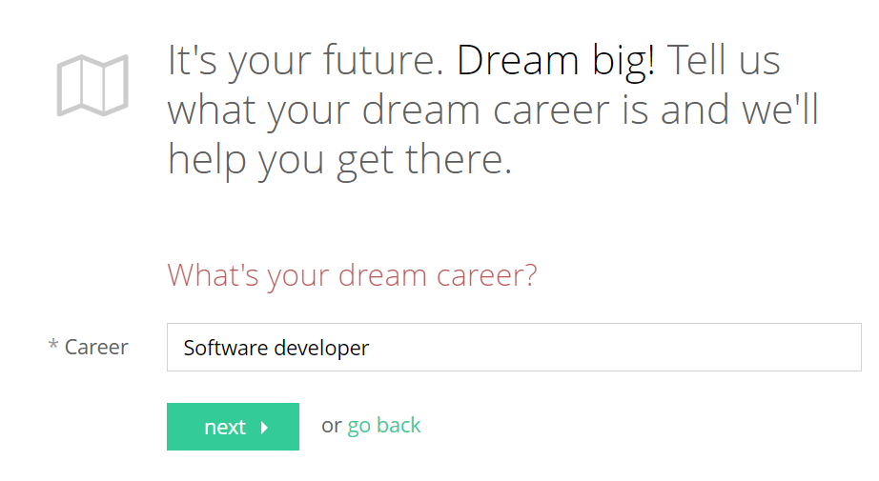
Using the Unifrog Post 18 intentions tool
To get started, enter your dream career!
Then click ‘next.’
Notes:
Teacher’s notes:
The next few slides will teach students how to navigate the platform to use the Post 18 Intentions tool.
Students are to enter their dream career and then click ‘next.’
Students can still enter their post 18 intentions even if they are currently unsure about their specific career aspirations. For example, they could write ‘A career in the theatre industry.’

Slide 5

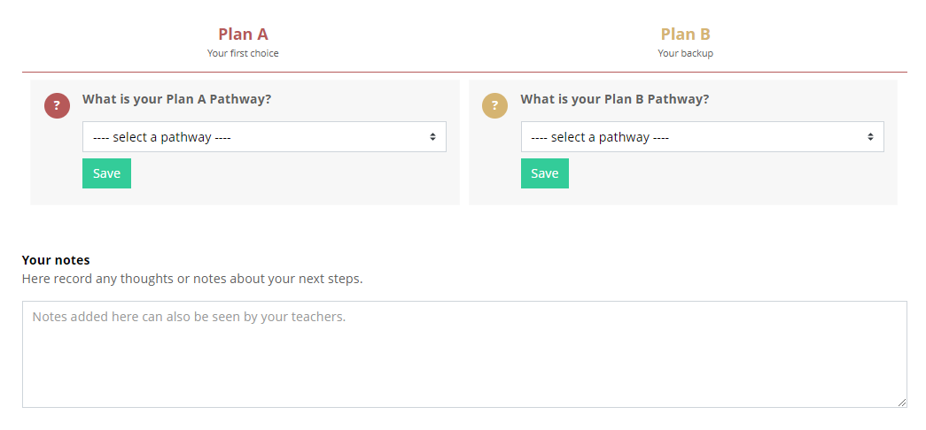
Using the Unifrog Post 18 intentions tool
You’ll then be able to enter your Plan A Pathway (your first choice) and your Plan B Pathway (your backup).
Notes:
Teacher’s notes:
The next few slides will teach students how to navigate the platform to use the Post 18 Intentions tool.
Students can enter two pathways:
Plan A (first choice)
Plan B (backup)
Students can also add notes that can be seen by their teachers. For example, a student may wish to explain why their Plan A Pathway is preferable to their Plan B Pathway.

Slide 6
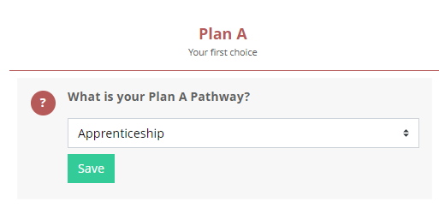
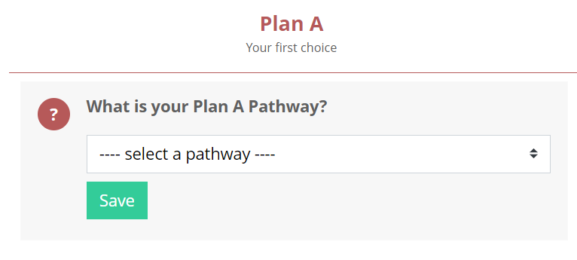
Using the Unifrog Post 18 intentions tool
Plan A Pathway: Select the pathway you’d like to follow from the dropdown list and then click ‘Save.’
You’ll then see further questions related to your selected pathway.
Notes:
Teacher’s notes:
The next few slides will teach students how to navigate the platform to use the Post 18 Intentions tool.
Students can select from the following pathways:
UK University
Apprenticeship
FE Course
Job
Non-UK University
Other
I don’t know

Slide 7
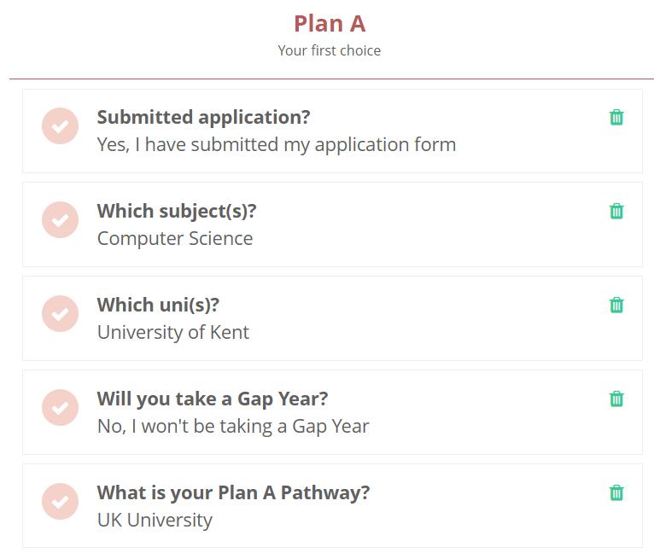
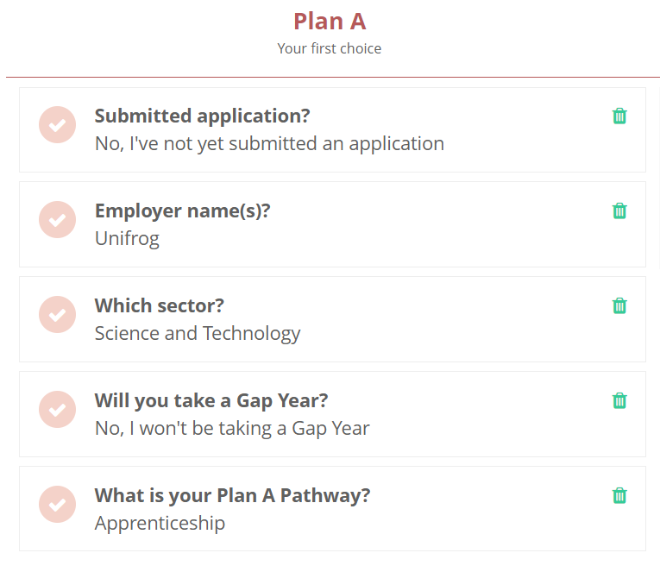
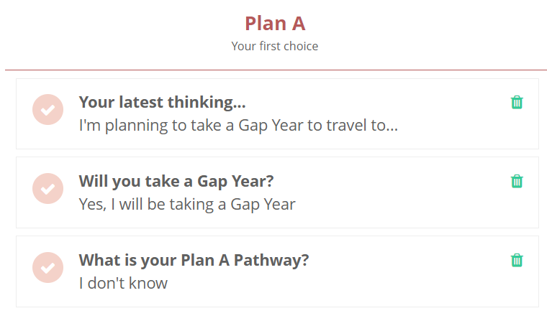
Using the Unifrog Post 18 intentions tool
You’ll then see further questions related to your selected pathway.
Notes:
Teacher’s notes:
The next few slides will teach students how to navigate the platform to use the Post 18 Intentions tool.
Students will be asked the following additional questions if they select UK University:
Will you take a Gap Year?
Which uni(s)?
Which subject(s)?
Submitted application?
Students will be asked the following additional questions if they select Apprenticeship or Job:
Will you take a Gap Year?
Which sector?
Employer name(s)?
Submitted application?
Students will be asked the following additional questions if they select FE Course:
Will you take a Gap Year?
Which qualification?
Which college?
Which subject(s) do you want to study?
Submitted application?
Students will be asked the following additional questions if they select Non-UK University:
Will you take a Gap Year?
Which country?
Which uni(s)?
Which subject(s)?
Submitted application?
Students will be asked the following additional questions if they select Other:
Will you take a Gap Year?
Tell us about it…
Students will be asked the following additional questions if they select I don’t know:
Will you take a Gap Year?
Your latest thinking…

Slide 8
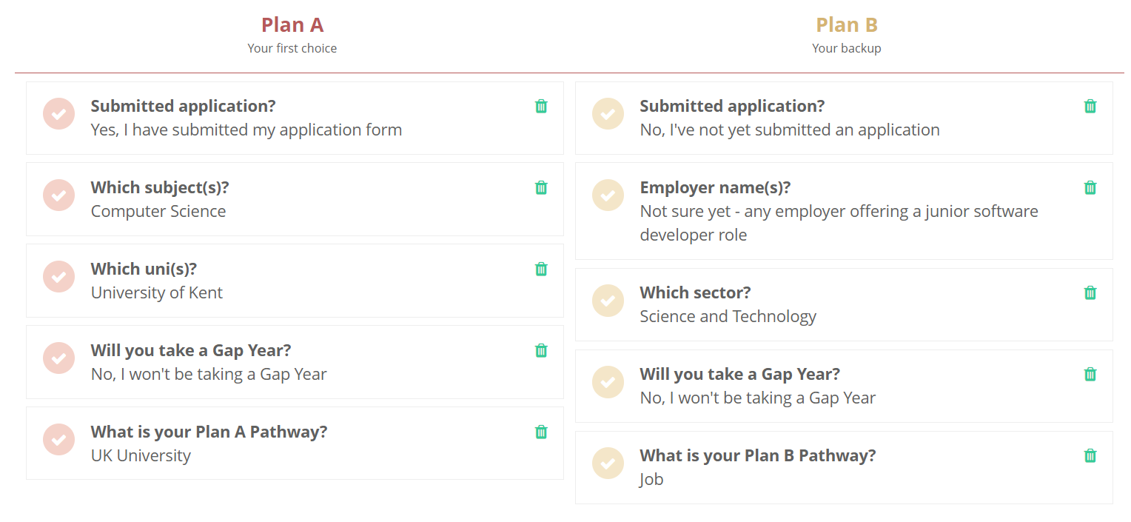

Using the Unifrog Post 18 intentions tool
Path B Pathway: Repeat the process for your backup plan. You’ll then be able to compare both of your plans side by side.
Notes:
Teacher’s notes:
The next few slides will teach students how to navigate the platform to use the Post 18 Intentions tool.
Students will be asked the following additional questions if they select UK University:
Will you take a Gap Year?
Which uni(s)?
Which subject(s)?
Submitted application?
Students will be asked the following additional questions if they select Apprenticeship or Job:
Will you take a Gap Year?
Which sector?
Employer name(s)?
Submitted application?
Students will be asked the following additional questions if they select FE Course:
Will you take a Gap Year?
Which qualification?
Which college?
Which subject(s) do you want to study?
Submitted application?
Students will be asked the following additional questions if they select Non-UK University:
Will you take a Gap Year?
Which country?
Which uni(s)?
Which subject(s)?
Submitted application?
Students will be asked the following additional questions if they select Other:
Will you take a Gap Year?
Tell us about it…
Students will be asked the following additional questions if they select I don’t know:
Will you take a Gap Year?
Your latest thinking…

Slide 9
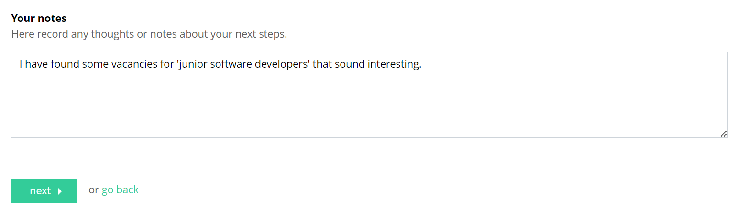
Using the Unifrog Post 18 intentions tool
Finally, you can add some notes for your teachers to read before clicking ‘next’.
Why do you want to follow these pathways?
Have you considered any other pathways?
Do you need any further information?
Do you need any support with your applications?
Do you know what you need to do next?
Are you still contemplating your options?
Notes:
Teacher’s notes:
The next few slides will teach students how to navigate the platform to use the Post 18 Intentions tool.
Students can enter two pathways:
Plan A (first choice)
Plan B (backup)
Students can also add notes that can be seen by their teachers. For example, a student may wish to explain why their Plan A Pathway is preferable to their Plan B Pathway.

Slide 10
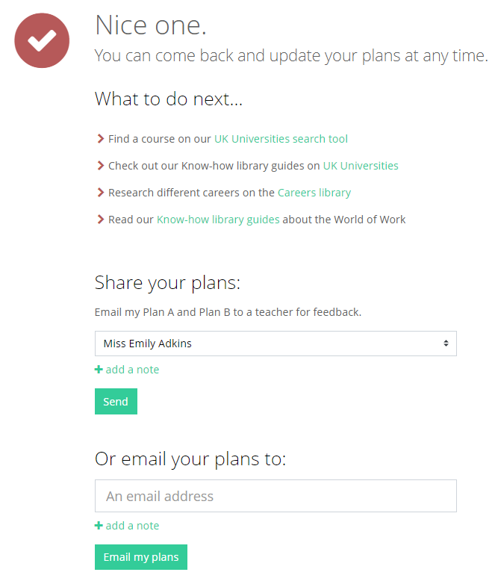

Using the Unifrog Post 18 intentions tool
Once complete, you’ll see recommendations related to your Plan A and Plan B Pathways, including search tools and Know-how library guides.
You can also ask for feedback from a teacher or email your plans to someone else.
Notes:
Teacher’s notes:
The next few slides will teach students how to navigate the platform to use the Post 18 Intentions tool.
Once their plans are complete, students can:
Follow links to related search tools
Follow links to related Know-how library guides
Send their plans to a teacher for feedback
Email their plans to someone else, such as a parent/carer
Tracking students’ progress:
You can track student progress with logging their intentions by clicking Advanced>Sort by>P18 Intentions.
From your homepage, you can also create charts showing intentions that have been logged. Go to Usage charts you can customise>Post 18 Intentions / Post 18 Intentions: Plan A pathways / Post 18 Intentions: Plan B pathways.

Slide 11

Recording your post 18 intentions
Now it’s your turn to record your pathways!
UK University
Apprenticeship
What is your Plan A Pathway?
What is your Plan B Pathway?
FE Course
Job
Non-UK University
Other
I don’t know
Notes:
Teacher’s notes:
Following the instructions in the last few slides, students will be able to record their Plan A and Plan B Pathways. (Student side>Post 18 Intentions).
Once students have entered their Plan A and Plan B Pathways, they can explore the recommended links to search tools and Know-how library guides.
Tracking students’ progress:
You can track student progress with logging their intentions by clicking Advanced>Sort by>P18 Intentions.
From your homepage, you can also create charts showing intentions that have been logged. Go to Usage charts you can customise>Post 18 Intentions / Post 18 Intentions: Plan A pathways / Post 18 Intentions: Plan B pathways.

Slide 12


