Slide 1




WALT:
Explain motor units and how a skeletal muscle contraction works.
WILF:
Identify key words
Explain the all-or-none law
Break down how a motor unit works

Slide 2
Retrieval – Label the heart.

Slide 3
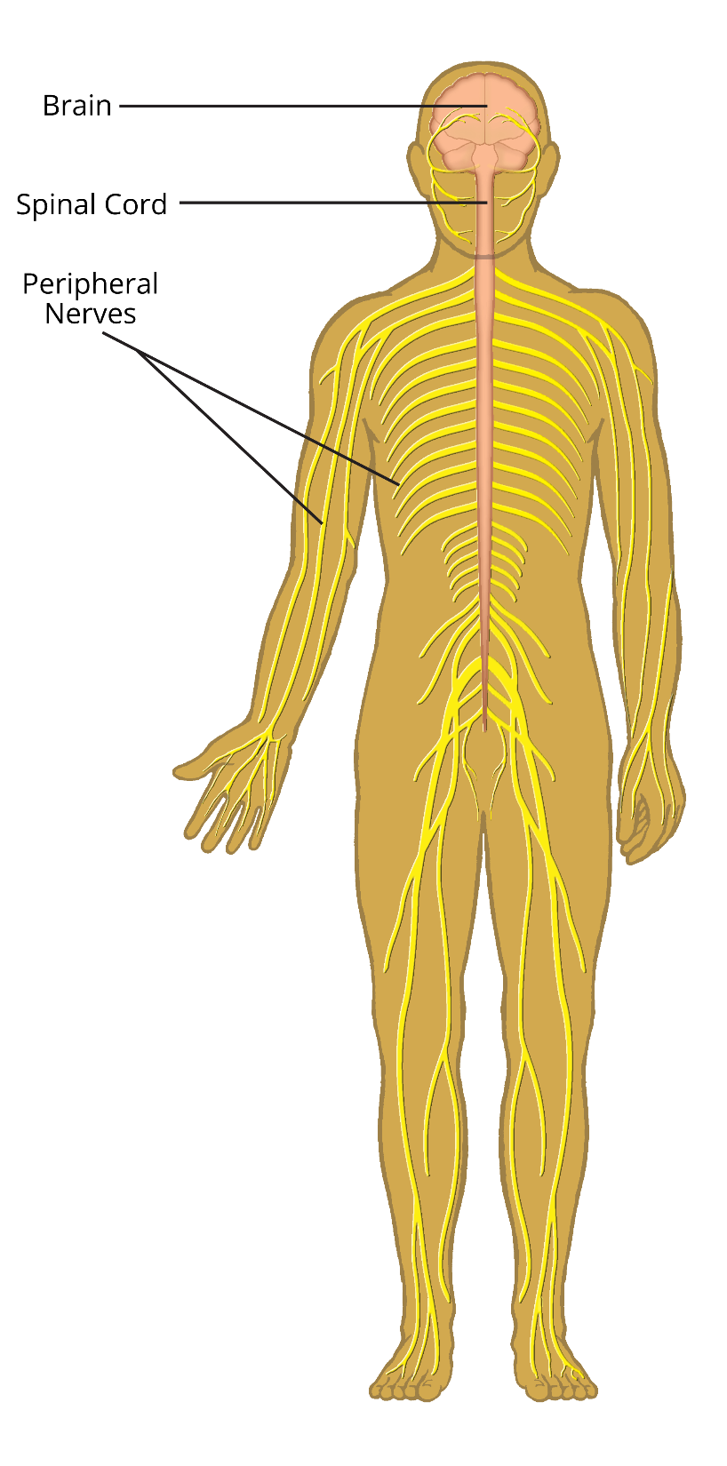
The CNS
The central nervous system
controls the body.
It’s made up of:
Brain
Spinal cord
Nerves
Sense organs

Slide 4
Sense Organs
Receptor cells in sense organs detect changes in the surroundings (a stimulus). The body can then bring about the correct response to this.

Slide 5

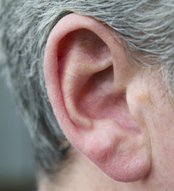
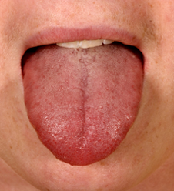
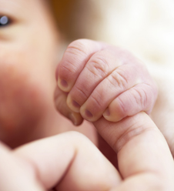
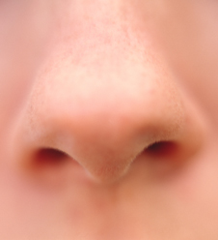
Name some sense organs in the human body

Slide 6
The Nervous System
The nervous system sends messages throughout the body as electrical signals called impulses.
A travelling impulse is called a neurotransmission and happens in the neurones (nerve cells).
There are several different types of neurones that have different roles in the CNS.
https://www.activeteachonline.com/product/view/id/512/page/35/mode/spftw?modal=/player/video/id/530987

Slide 7
Pathway of a Nerve Impulse
Stimulus eg. smelling food
Impulse starts at r_________ (n____)
Impulse passed along s_________ neurone
eceptor
ose
ensory
Fill in the gaps on the flowchart explaining the pathway of a nerve.
Impulse travels to C________ N_________ S__________
entral
ervous
ystem
E_________ (muscle) receives impulse to react
ffector
Response – walk to food shop
Impulse passed along m______ neurone
otor

Slide 8




Notes…
Motor unit functions to carry nerve impulses from the brain and the spinal cord to the muscle fibres, initiating muscular contraction.
Motor neurons are specialised cells which transmit nerve impulses rapidly to a group of muscle fibres. They have a cell body in the brain or spinal cord with an extending axon which branches to connect motor end plates to a group of muscle fibres.
Sending the nerve impulse to the muscle fibres is an electrochemical process which relies on a nerve action potential to conduct the nerve impulse as a wave of electrical charge down the axon to the end plates.
The point where the axon’s motor end plates meet the muscle fibres is call the neuromuscular junction.

Slide 9



Notes…
There is a small gap between the motor end plates and muscle fibre called the synaptic cleft. An action potential cannot cross a synaptic cleft without the neurotransmitter acetylcholine (ACh).
The neurotransmitter is secreted into the synaptic cleft to help the nerve impulse cross the gap.
If enough of the neurotransmitter is secreted and the electrical charge is above threshold, a muscle action potential is created. This results in a wave of contraction down the muscle fibres.

Slide 10
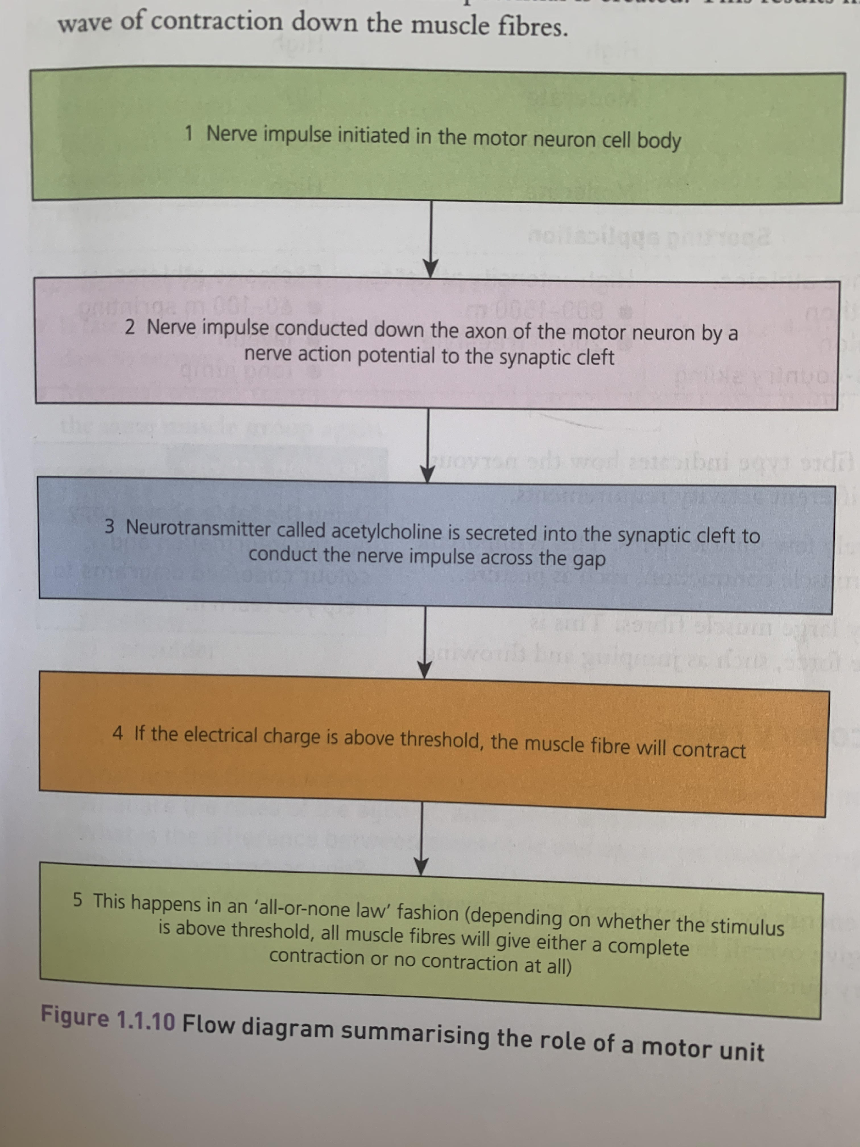

Slide 11
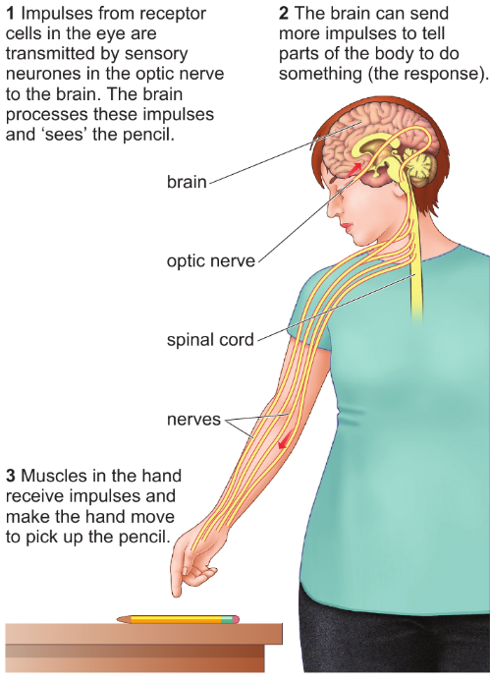
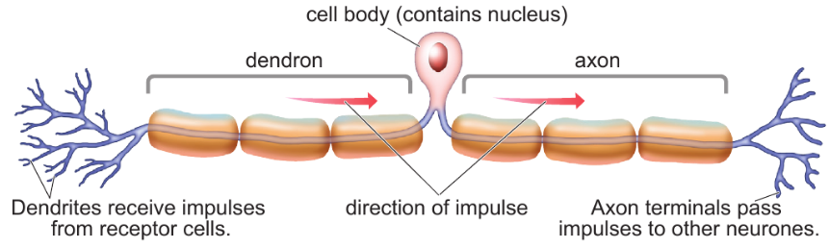
Neurones

Slide 12
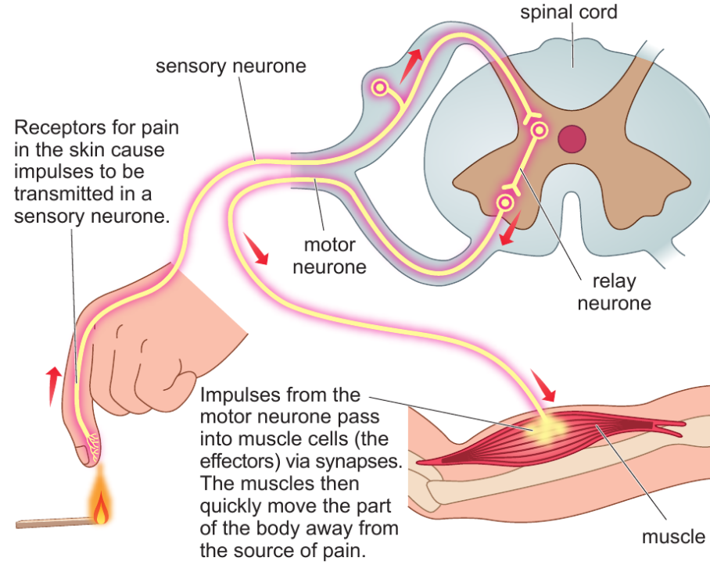
The
Reflex
Arc

Slide 13
Synapses
Neurones meet each other at synapses, which contain a tiny gap.
Impulse reaches an axon terminal
A neurotransmitters substance is released across the gap
This is detected by the next neurone
New impulse generated

Slide 14
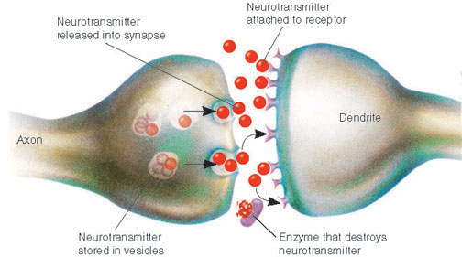
Synapses
Neurones meet each other at synapses, which contain a tiny gap.

Slide 15
https://www.youtube.com/watch?v=WhowH0kb7n0

Slide 16
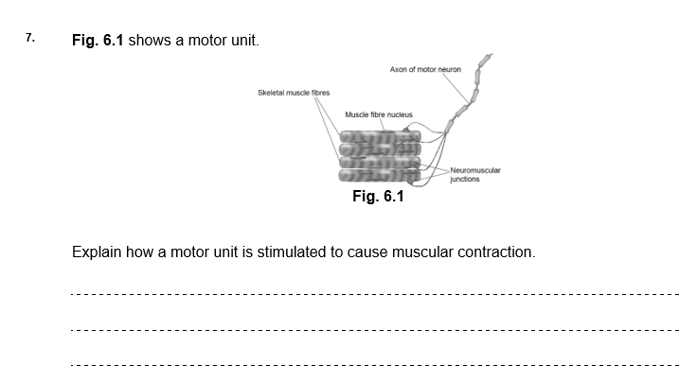
Let’s have a go at an exam question!

Slide 17


