Slide 1
WALT: Understand movement patterns
WHY? Red on RAG
WILF:
Correct definitions
Clear sporting examples in relation to movements

Slide 2
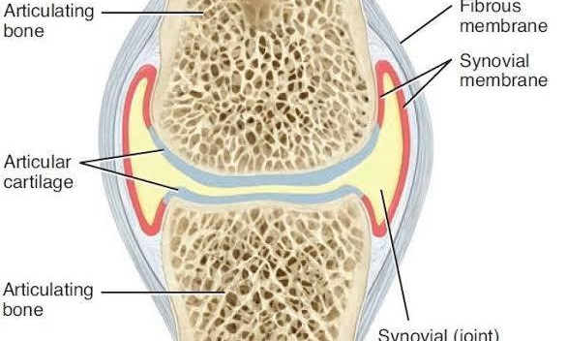
Retrieval - Label the synovial joint structure & function.
c
c
c
c
c

Slide 3
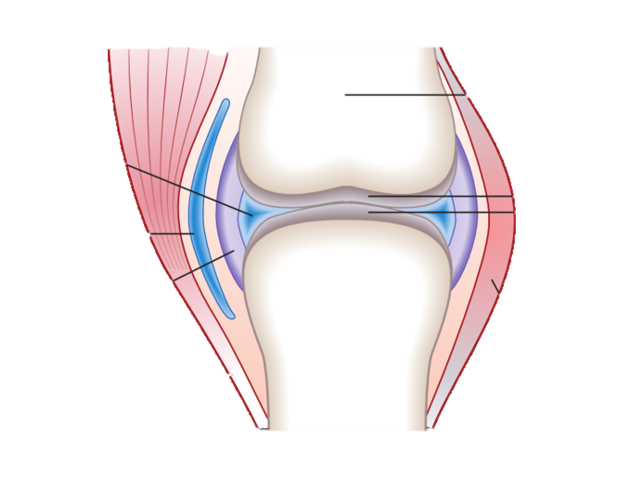
Structure answers
Bone
Synovial cavity and fluid
Articular cartilage
Bursa
Articular cartilage
Joint Capsule
Ligament

Slide 4
Common features of a synovial joint | structure | function
Ligament | A tough band of slightly elastic connective tissue | Connects bone to bone and stabilizes joint during movement
Synovial fluid | Lubricating liquid contained within the joint cavity | Reduces friction and nourishes articular cartilage
Articular cartilage | Smooth tissue which covers the surface of articulating bones | Absorbs shock and allows friction-free movement
Joint capsule | A fibrous sac with an inner synovial membrane | Encloses and strengthens the joint secreting synovial fluid
Bursa | A closed, fluid-filled sac found where tendons rub over bones | Reduces friction between tendons and bones

Slide 5
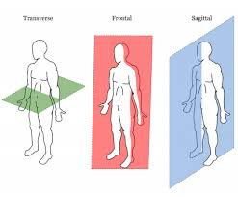
Planes of movement...
Sagittal plane – divides left to right
Frontal plane – divides front to back
Transverse plane – divides upper (superior) and lower (inferior)

Slide 6
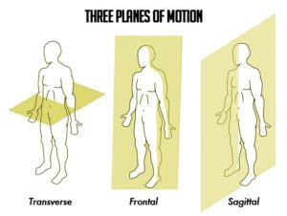

Slide 7
Frontal Plane
This plane divides the body into front (anterior) and back (posterior).
Movements must always be along this plane – adduction and abduction of the arms along this line
e.g. performing a star jump.

Slide 8
Transverse Plane
This divides the body into top and bottom.
Movements must always be along this plane - rotation
e.g. twisting of the hips

Slide 9
Sagittal Plane
This divides the body into left and right through the middle of the body.
Movements must be up and down along this line and not sideways – flexion and extension
e.g. a bicep curl or a squat

Slide 10
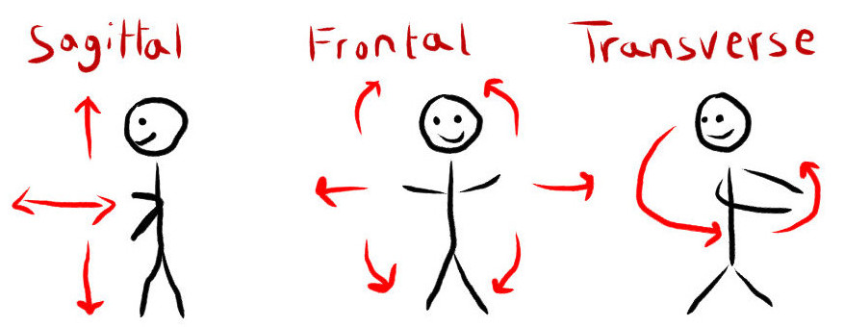

Slide 11
Sagittal plane
Examples?
Flexion
Extension
Dorsi-flexion
Plantar flexion
Flexion: upward phase of bicep curl & at the elbow joint.
Where do they occur?
Extension: downward phase of bicep curl & at the elbow joint.
Dorsi-Flexion: brings toes up preparing to perform a jump shot in basketball & at the ankle joint
Plantar Flexion: pointing toes downwards when taking off in the high jump & at the ankle joint.

Slide 12
Frontal plane
Examples?
Abduction
Adduction
Abduction: upward phase of a lateral raise from the midline of the body & at the shoulder joint.
Where do they occur?
Adduction: downward phase of a lateral raise closer to the midline of the body & at the shoulder joint.

Slide 13
Transverse plane
Examples?
Horizontal flexion
Horizontal extension
Rotation
Where do they occur?
Horizontal flexion: forwards swing when performing a discus throw & at shoulder joint
Horizontal Extension: backwards swing when performing a discus throw & at the shoulder joint.
Rotation: tennis forehand top spin & at the shoulder joint
Longitudinal axis: this line runs from top to bottom through the centre of the body.

Slide 14
Planes of Movement
https://www.youtube.com/watch?v=tgri5TIp6p0
Plane | Movement | Example
Frontal (vertical, front to back) | Abduction & adduction | Legs at the hip joint; jumping jack
Transverse (upper & lower) | Rotation | Arm action when bowling in cricket
Sagittal (vertical, left to right) | Flexion & extension | Leg action in running

Slide 15
Exam Questions:
Planes of movement are split into three types. One of them is the Sagittal Plane what are the other two planes? (2)
Explain the sagittal plane of movement giving practical examples
(3)
Which plane of movement allows for adduction and abduction?
        (1)
Which plane of movement allows for flexion? (1)

