Slide 1
WALT: to know the major muscles on the body and how they move.
Why?: link to our bones revision to understand movement.
WILF:
To label the major muscles on the body and describe how they attach using the correct terminology.
To discuss the antagonistic muscle action that takes place when movement occurs.

Slide 2
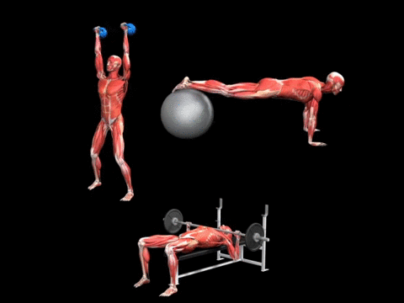
Why do we need our muscular system?
Primary function = to create movement.

Slide 3
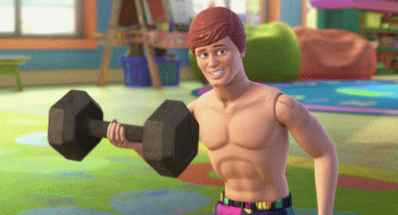
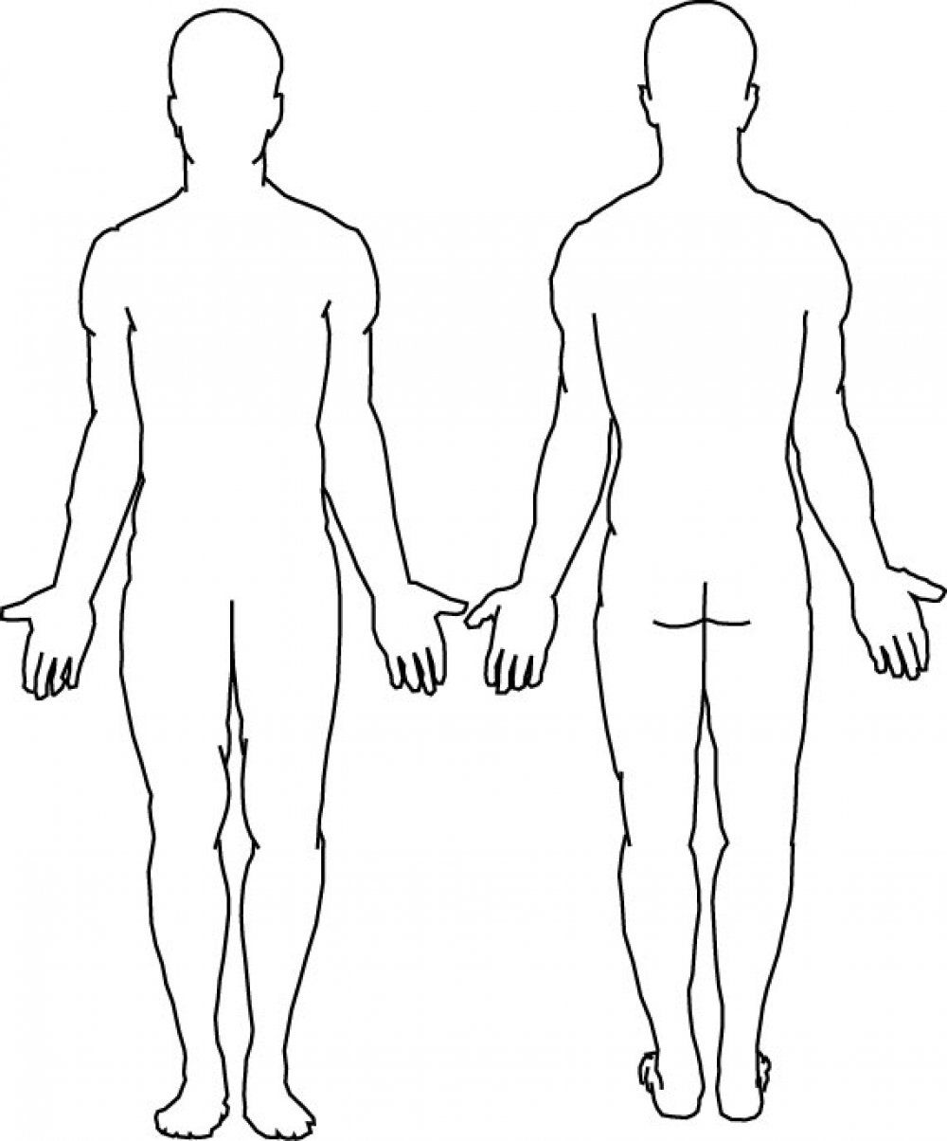
What muscles do you know?
On the body can you label as many muscles as you know in silence!
Now talk to the person next to you and add more!
Now discuss as a group to see if you can add any others!

Slide 4
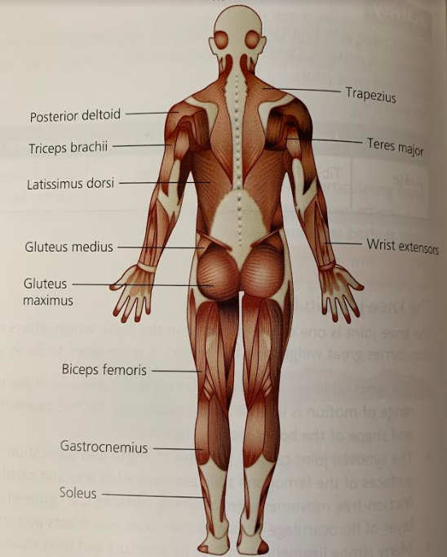
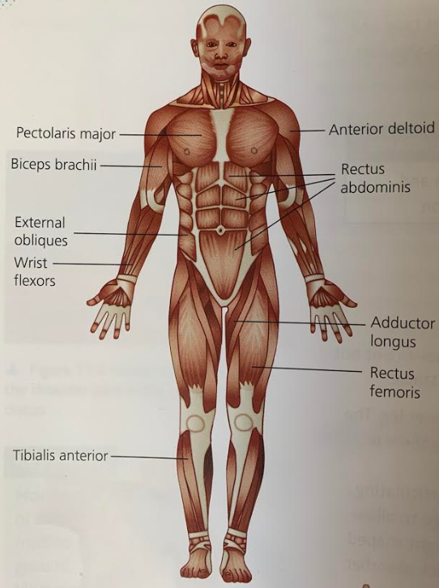
How many did you know?
How to muscles attach to bones?

Slide 5
Key words:
Tendon
Agonist
Antagonist
Fixator
Antagonistic muscle action
Isotonic contraction
Concentric contraction
Eccentric contraction
Isometric contraction
Delayed onset muscle soreness
Types of movement
What are they?

Slide 6
Points of attachment…
Tendons: a fibrous connective tissue that attaches a muscle to bone.
EXTRA!!
Each muscle is composed of many fibres (these contain filaments) encased in connective tissue forming tendons at either end.
Thick filaments are made of the protein myosin and thin filaments are made of the protein actin.
Myosin and actin filaments are arranged to form an overlapping pattern which gives muscles tissue its striated appearance.
Tendons transmit the pull force created by the muscle to move the bones they are attached to.
Points of attachment: Origin & Insertion
Origin = the point of muscular attachment to a stationary bone which stays relatively fixed during muscular contraction.
E.g biceps brachii origin is on the scapula during a bicep curl.
Insertion = the point of muscular attachment to a moveable bone which gets closer to the origin during muscular contraction.
E.g. the biceps brachii’s insertion is on the radius during a bicep curl.
Myosin and actin filaments: proteins which form the contractile units of skeletal muscles.

Slide 7
Antagonistic muscle action
Movement | Agonist | Antagonist
Flexion (wrist) | Wrist flexors | Wrist extensors
Flexion (elbow) | Biceps brachii | Triceps brachii
Flexion (shoulder) | Anterior deltoid | Posterior deltoid
Flexion (knee) | Bicep femoris (hamstring group) | Rectus femoris (quadriceps group)
Flexion (hip) | Ilipsoas | Gluteus maximus
Dorsi-flexion (ankle) | Tibialis anterior | Gastrocnemius and soleus
The common pairings for flexion
Muscles work in pairs or groups to produced co-ordinated movement.
Key words: agonist, antagonist, fixator, antagonistic muscle action.
Can you use these keys words to explain kicking a football?
In pairs write down what you think those definitions are…

Slide 8
Muscle contraction…
A muscle uses energy to create force. It is the force that can create movement.
A muscle has 3 potential contractions: concentric, eccentric and isometric.
Key words: isotonic, concentric, eccentric, isometric contractions.
DOMS: delayed onset muscle soreness, pain and stiffness felt in the muscle which peaks 24-72 hours after exercise, associated with eccentric muscle contractions.
https://www.youtube.com/watch?v=NoHSGRvK3jg

Slide 9
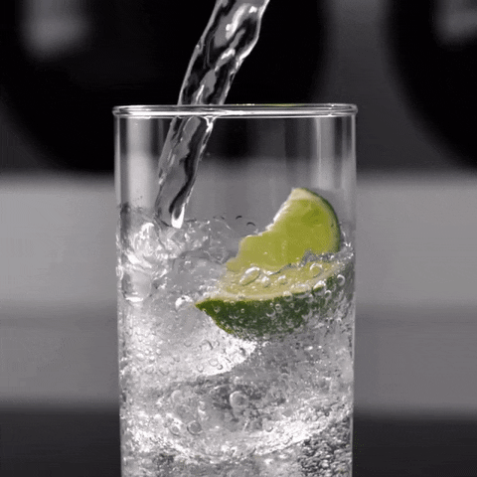
Isotonic…
Concentric:
This produces the force to pull two bones closer together causing joint movement. E.g. upwards movement of bicep curl (biceps brachii concentrically contracts)
Eccentric:
This resists forces, such as gravity, to control joint movement. E.g. downwards movement of bicep curl (biceps bracchi eccentrically contracts)

Slide 10
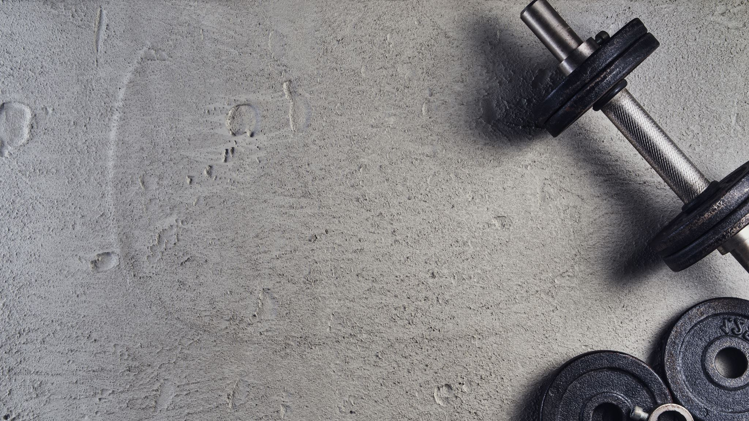
Isometric…
E.g. biceps brachii holding a free weight in the hand still. The muscle will create tension as it pulls on the tendon attachments, however no movement is created. Posture is maintained by muscles isometrically contracting.

