Slide 1



Exam Stress

Slide 2



What is exam stress and anxiety?
Anxiety affects 1 in 3 people in their lifetime and it can have a significant impact on their life.
Anxiety can begin to interfere with going out and socialising, sleeping, having fun and eating.

Slide 3
What does anxiety look and feel like?
Headache | Tense jaw | Behaviours | Jelly legs
Dizziness | Heart racing | Extra energy | Tingling
Stomach pain | Restless | Need to use toilet | Racing thoughts
Butterflies | Feeling sick | Dry mouth | Tight throat
Sweating | Trouble sleeping | Foggy brain | Shaking

Slide 4
So, why do we get stressed or anxious?
Fear of failure
Perfectionism
Pressure from others
Negative past experiences
Not feeling prepared
Unhelpful thinking

Slide 5
General exam stress-busting tips
Prioritise your time when revising
Make a revision timetable
Exercise and eat healthily
Take breaks from social media before exams
Put your worries into perspective
Do mock exams at home
Improve your exam time management

Slide 6
Revision tips
Leave plenty of time to revise so that you don't have to do last- minute cramming.
Develop a timetable so that you can track and monitor your progress.
Allow time for fun and relaxation.
Take a short break as soon as you notice your mind is losing concentration, but don't get distracted.
Experiment with alternative revision techniques.
Don't drink too much coffee, tea or fizzy drinks; the caffeine will make your thinking less clear.
Regular moderate exercise will boost your energy, clear your mind, reduce feelings of stress and help you sleep better.

Slide 7
7 revision techniques for GCSE & A-Level
Flashcards, Flashcards and More Flashcards!
YouTube Tutorials Are Heavily Underrated
The Pomodoro Technique
Mind Maps Past Papers
Teach Someone Else
Group Revision

Slide 8
Tips for the exam itself
It's natural to feel some exam nerves but don't panic.
The quickest and most effective way to eliminate feelings of stress and panic is to close your eyes and take several long, slow deep breaths.
Give yourself a mental pep-talk by repeating "I am calm" or "I know I will do fine"
Survey what’s in front of you
Prioritise what needs to be done
Pace yourself

Slide 9
Managing mental blocks in the exam
Deep-breathing exercises
Memory recovery
Imagine you know the answer and see what comes to mind
Try not to keep staring at the question – brain research suggests the position of the eyes is important: look up as you try and remember it
Create a mind map of what you do remember – the power of association can trigger your memory Begin with questions you can answer – add anything you remember to your mind map while you are doing this

Slide 10
After the exam
Don't spend endless time criticising yourself for where you think you went wrong. Congratulate yourself for the things you did right, learn from the bits where you know you could have done better, and then move on.
Plan to reward yourself for your hard work. After the exam, do something you enjoy. If you are going to meet up with someone, you could agree with them that you will only talk about the exam for 5 minutes - or even not at all.
It’s important that you let the stress of the exam go, especially if you have more exams to sit.

Slide 11
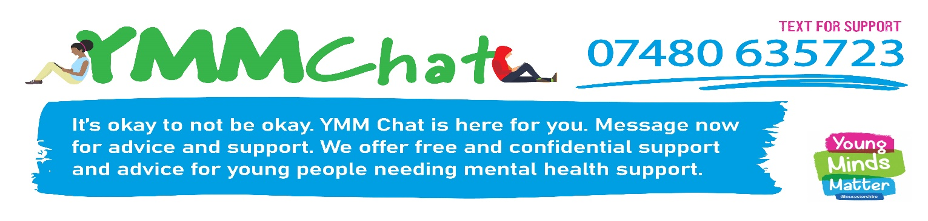
Where to get help
You can self refer into YMM and see someone confidentially at school or just have a text chat through YMMChat ;
Teens in Crisis www.ticplus.org.uk Tel: 01594 372777
Childline www.childline.org.uk 0800 1111 (free; 24 hr)
YoungMinds Parent Helpline 0808 802 5544
On Your Mind www.onyourmindglos.nhs.uk
ChatHealth confidential advice from a school nurse
Text: 07507 333351 (Mon-Fri 9-4.30)
Gloucestershire Self Harm Helpline www.gloucestershireselfharm.org

Slide 12



