Slide 1
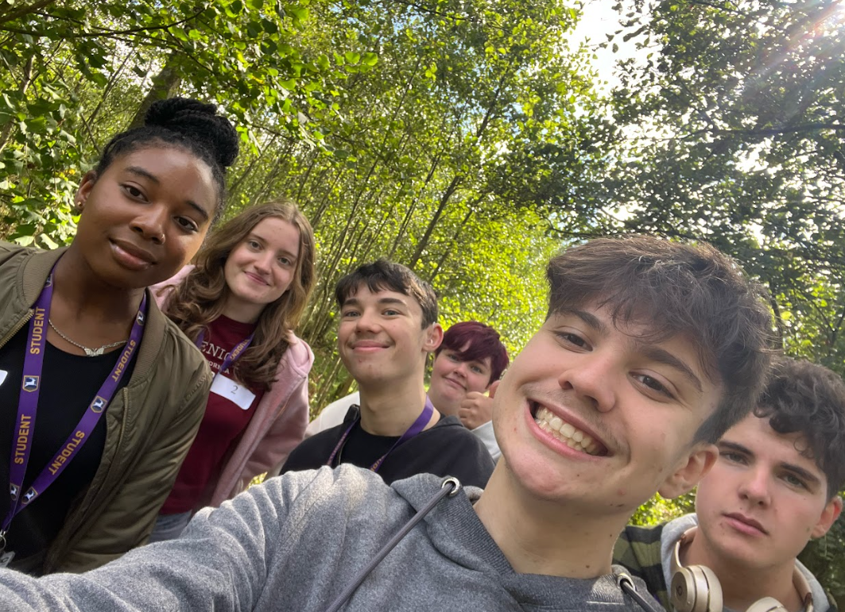
Year 12 Information Evening
Welcome

Slide 2
The sixth form team
Liz Balmer - Head of Sixth Form
Julie Russell & Sarai Davies- Sixth Form Office managers
Hazel Partridge - Attendance officer and iStudy mentor
Jo Rich - Careers advisor
Marie Hamm- Wellbeing support
Mara MacMaster - Counsellor

Slide 3
The Sixth Form pastoral team
Tutors and academic mentors:
Natasha Cook
Neil Matthews
Catherine Allison
Sam Buckley

Slide 4
The basics
Registration at 8.45
Lessons end at 3.20
Please call into the sixth form to report an absence.
01594 838549
Please always get in touch if there’s a problem.
6thform@denemagna.gloucs.sch.uk

Slide 5
Our priorities
Academic success - meet your maximum potential
Focus on the future - where are you going?
Growth - become a confident and resilient adult.

Slide 6
Attendance & absence
Good attendance is key to good results
Unavoidable absence - call in to let us know
Attendance officer - Hazel Partridge
If attendance drops, we talk to you.

Slide 7
Studying for A Levels
•Tough! Greater quantity of work
•An expectation that students can demonstrate higher order skills
•Greater amount of independent study
•Lessons may be different – class sizes; expectations of teachers; relationships
•An emphasis on the future

Slide 8
Achieving academic success
Timetabled sessions:-
9 sessions per A level
3 hours iStudy per subject
Enrichment
Academic tutoring sessions
Super-curricular experiences
Free time for clubs, socialising

Slide 9
What do we know about each student?
Each is an individual
Your average GCSE results
Your subject specific outcomes
Other relevant key factors
Each individual is different and target setting is not defining who anybody is or what they will achieve
Whatever their target grade, all grades are still possible

Slide 10
Approach to Learning
Independent “above and beyond”
Guided “keen to do well”
Supported “will do enough to get the job done”
Minimal “lacks drive and motivation”

Slide 11
Wellbeing
Pastoral support - tutor team
Academic support - teachers, mentors
Wellbeing support - Marie
Counselling and external support
Home/school relationship

Slide 12
An emphasis on the future
Unifrog - careers and universities platform
UCAS - the Universities applications service
Apprenticeships info and application support
Open event and careers fair in the new year

