Slide 1


Slide 2

Benefits of Work Experience
Gain an insight into the world of work
Develop your skills
Looks good on future applications
Helps give you confidence
Helps you in interviews
Make useful contacts
Work out what you like and don’t like
Get exposure to management
Gain practical knowledge
May help your motivation to do well
Helps put school into perspective

Slide 3
When to do Your Work Experience
13th – 17th October 2025 5 day work experience (you will need to start contacting places now)
AND/OR 29th June – 3rd July 2026 (please note you will miss out on a trip to Draytom manor if you choose this week).
You can pick both weeks should you wish and experience two different job sectors
If the employer you want to work with can’t accommodate you on either of these weeks we can be flexible but you MUST check with all of your teachers first that you won’t be missing anything important e.g. Y10 Trial Exams in June, and must catch up on work missed.
If you don’t want to catch up on work missed you can organise your work experience to take place during the holidays.

Slide 4

Top Tips to find a Placement
Google employers in sectors you are interested in and ask your parents/carers if they have any contacts or can ask on their social media e.g. LinkedIn, Facebook
A spreadsheet with a list of ideas will be sent to you by email (Y10 Careers Google Classroom).
Remember to make sure that you are able to travel to and from your placement.
If you are interested in careers where it’s difficult to get a placement think outside the box e.g. if you’re interested in becoming a vet but can’t find a placement at a Veterinary Surgery look for placements in animal conservation, livery yards, Zoos, Birdland, Farm parks etc.
Try to avoid a placement with your family as you won’t get a ‘real’ experience of the world of work.
There are virtual work experience opportunities around e.g. google Springpod.

Slide 5
What happens if I can’t find any Work Experience?
Please email Mrs Rich and ask for help if you have any problems finding work experience.
If you haven’t organised any work experience by the end of June 2026 you will attend 3 days of Careers Related Learning/Visits in school with Mrs Rich on the 1st -3rd July.

Slide 6
How to set up your Work Experience (WEX)
Speak to or email employers and agree a week that works for you and them. You can find some wording on the flyer here: https://www.denemagna.co.uk/page/?title=Work+Experience+%28yrs+10+%26amp%3B+12%29&pid=58
Once you have agreed a date with the employer you must get their email address and your parent/carers email address so that you can complete the application on Unifrog. It is essential that you have the correct email addresses written down.
Log your placement onto Unifrog (instructions will be sent to you via Google Classroom and your Tutors will also have a copy.
ALL PLACEMENTS MUST BE LOGGED ON UNIFROG AND YOU CAN’T GO UNTIL YOU’VE HAD AN EMAIL CONFIRMING IT HAS BEEN APPROVED (THIS IS FOR YOUR OWN SAFETY)

Slide 7


Work Experience
Yrs 10
We administer the whole work experience programme through the Unifrog Work Placement Tool.
Unifrog Work Placement Video

Slide 8
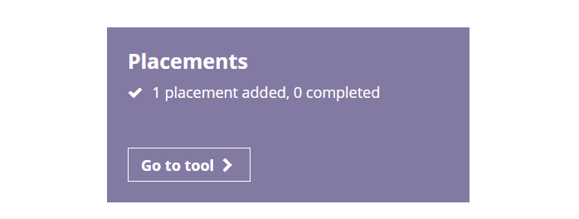
Unifrog Instructions:
(THIS MUST BE DONE AT LEAST 2 WEEKS BEFORE YOUR PLACEMENT IS DUE TO START)
Log into Unifrog
Click on the ‘Go to tool’ arrow on the Placements tab
3) Click on + Add New Placement
4) Complete all sections. Please select Mrs Rich as the Placement Co-ordinator and in the ‘Describe the time commitment’ section ensure you put your agreed start and end times e.g. 9am to 5pm
5) Click to Agree to the 4 points
6) Click Mark as finished
7) Click Add Placement
You’ll receive emails confirming the status of your application throughout the process.
If, for some reason, you can’t set up your placement through Unifrog please email Mrs Rich for help.

Slide 9
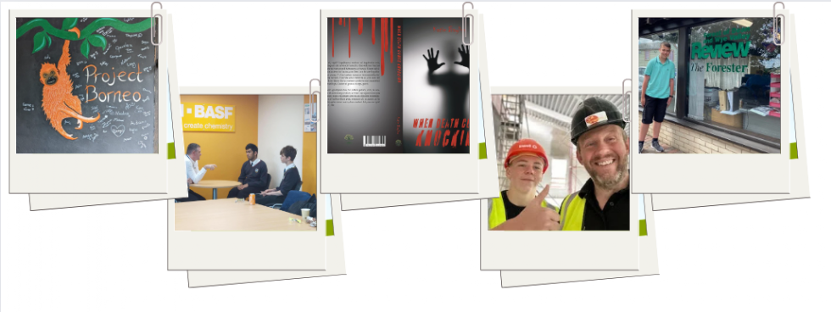

Inspiration
One of our Year 10 students was asked to apply in Year 11 for a sought after Apprenticeship and was subsequently offered the job.
One of our Year 12 students was asked to apply for a 5 year Level 4-7, Degree Apprenticeship with the Accountancy company she completed her work experience with.

Slide 10
Thank you for your time
Work Experience Ideas (please note the different tabs, you can sort by job sector):
https://docs.google.com/spreadsheets/d/1licMaHsix73wNoDvtewQy3DQqcbHHVWQLLPjetJP15k/edit?gid=697976432#gid=697976432
Careers pages with handy hints for Work Placements and wording on the school Website:
https://www.denemagna.co.uk/page/?title=Careers%3A+Years+7+to+13&pid=227
Follow Dene Magna Careers on Facebook:
https://www.facebook.com/Dene-Magna-Careers-106752851965798

