Slide 1
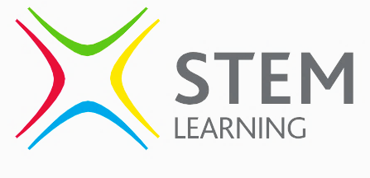







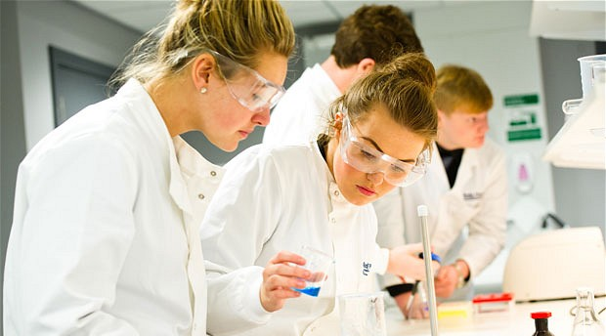

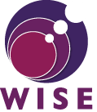

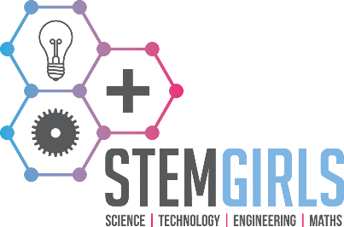

All inclusive
Currently, there are far more men working in STEM environments than women. This is largely the result of stereotypes of the past, and girls being discouraged from STEM careers. It’s a serious problem today, with three times more boys than girls studying at least one STEM subject at A Level, and nine times more boys than girls studying a STEM subject at University. Nationally this is a recognised crisis, and the UK Government wants to encourage young people to consider all options as they look to their own education and careers.
Whilst most STEM activities and events at Dene Magna include both boys and girls, some of our events are designed to break any negative assumptions regarding gender. We want boys and girls to explore all the opportunities available to them today.
π
SCIENCE TECHNOLOGY ENGINEERING MATHS
S
T
E
M
DENE MAGNA
A significant voice in the wider community
Our encouragement of STEM isn’t confined to our own students. The local challenge in the Forest needs a wider perspective, so we also work with our partner primary schools, hosting STEM activity days, inviting students to also hear from guest professions and sharing our teaching expertise.
Stay up to date with our STEM activities through our FaceBook page ‘Dene Magna STEM’
Fostering a love of technical
learning and careers
STEM Lead Teacher: Mr Jones s.jones@denemagna.org.uk

Slide 2
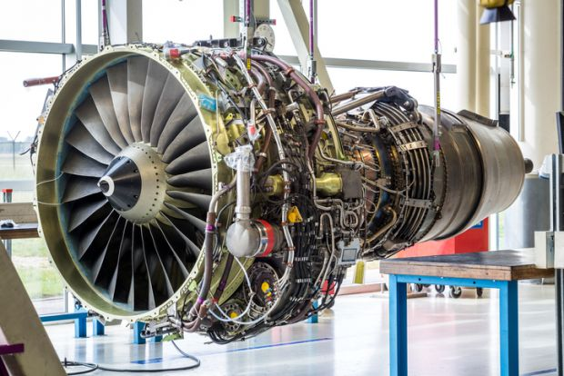

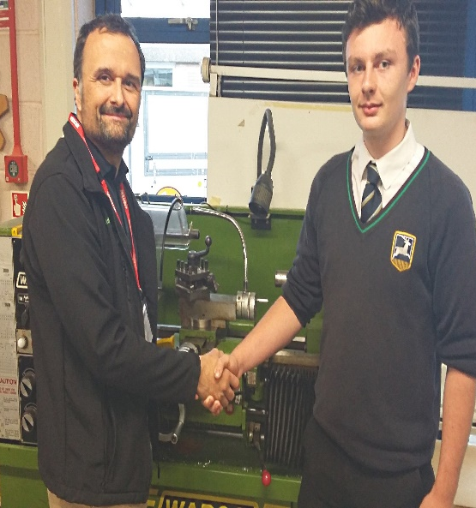

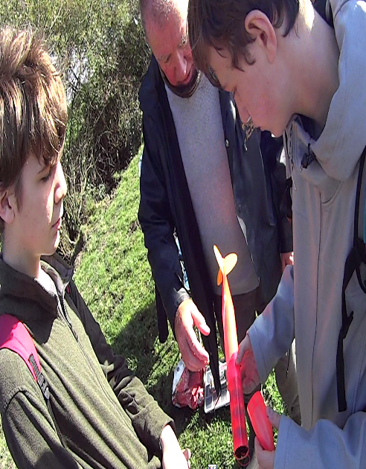

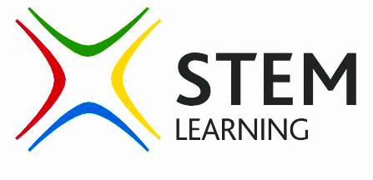
STEM – a national legacy
Fostering a love of STEM
The UK has a proud heritage of innovation. British engineers have been instrumental in the invention or development of many world changing technologies like the telephone, computer, steam train, TV and jet engine. The UK continues to have significant influence in the fields of Architecture, Medicine, Aerospace, Science, Maths and all types of Engineering. Looking ahead, technology has never moved at such rapid pace with constant development in communication, energy, transportation, medicine and artificial intelligence.
At Dene Magna, our response to the national and local STEM challenge is not to force any student down a particular path, but to simply expose students to the wide array of technological careers that exist. We do this by offering them encounters with people, encounters with work environments and encounters with information. Through a sustained focus on STEM, students are more aware of career and educational
opportunities, and by meeting inspiring individuals, stereotypes can
be challenged and eyes can be opened to new possibilities.
Our STEM Strategy:
Yet there is a problem – there are too few young minds entering these fields, leaving a shortfall in the current employment market (173,000 STEM jobs unfilled as of 2018) , and a serious hole in these essential areas as we look to the future (STEM jobs are expected to double in the next 10 years). Employers are being forced to invest in skills abroad and there is widespread concern that our country could fall behind in technical advancement if young people don’t bring fresh ideas and innovation. Too few students are entering professional careers despite the opportunities on offer.
Exposure to industry. By partnering with local and national industries, students are able to visit and experience different STEM workplaces. Whether visiting engineering factories, medical facilities or design centres, students have a clearer view of STEM careers and the different paths available.
STEM Activity Events. We work with local and national initiatives to host different themed days in school. Students from all key stages enjoy hands on learning activities led by external guests. The school also participates in theme career weeks like Space Week, British Science Week or Maths Week, and host invited professionals to have lunch with groups of interested students. Dentists, Vets, Inventors, Pilots and more come and speak to students, and give first hand experience of their industry.
A local challenge
We live in a beautiful region of our country, offering a relaxed pace of life and being listed as a top place to raise a family. However, Forest of Dean young people are lagging behind in careers. Ambition in our children and teenagers is far lower than average, with only 15% of Forest students even considering higher education at all (amongst the lowest in the UK). Our area is also ranked in the bottom 5% for social mobility (the ability for children to improve on the lifestyle and income of their parents). All this means that educationally, young people in our area may find it difficult to break through any low expectations set by their community or their parents.
Competitive engagement. Through internal and external competition, we encourage creativity and engagement with problem solving. The school has entered (and won) national STEM competitions, and students thrive on the challenge and enjoyment that comes with participation.
STEM Clubs. Different departments offer lunchtime or after-school clubs to stir interest in all sorts of STEM directions. We offer a wide range of science, construction, design and engineering clubs.
Yet at Dene Magna we don’t believe that low expectations should be normal. We don’t apologise for encouraging students to aim for and expect great things of themselves. Our goal is to fuel the ambition and aspiration of not only Dene Magna students, but through our STEM initiatives, spark ambition in students across the Forest. Why can’t the next inventor, communicator or pioneer come from the Forest of Dean? He or she may have started their journey at Dene Magna.
Targeted work experience. In year 10, students are encouraged to match their work experience to their career path. To access the best placements, students are able to take a week out of lessons to show flexibility to the employer.
Integrated project teaching. At different times in the year, separate subject curriculums are merged and students work on projects that require understanding and application of skills from different subject departments in the school.

