Slide 1
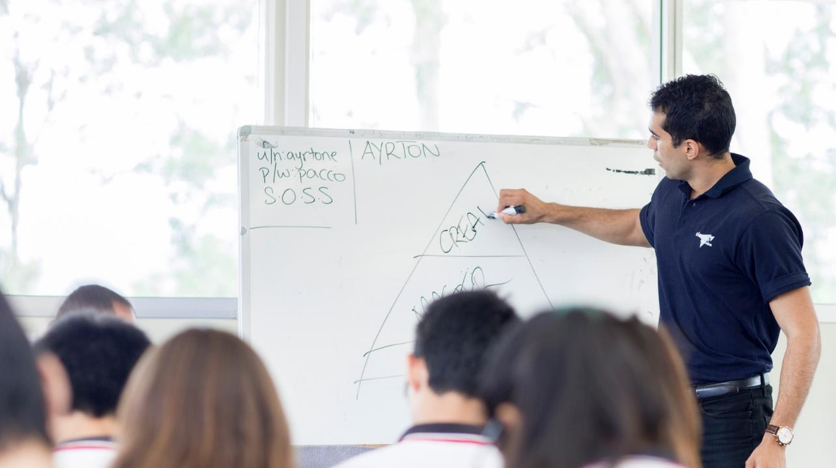
Parent
Seminar

Slide 2




Elevate Education – Who are we?
Research: Why do the top students get the top results?
Work with the top students around the world (2000+ schools, across 5 countries)
13 key study habits

Slide 3
13 key skills
Success
Belief
Goals
Environment
Team
Results oriented
Organization skills
Use of holidays
Independent work
Practice questions/mock exams
Exam preparation
Memory skills
Post Exam
Stress

Slide 4
Elevate Parent Seminar
Time Management

Slide 5
Elevate Education – Study Timetables
What?
When?
Sport
What?
When?
Social
What?
When?
Hobbies
What?
When?
TV
What?
When?
Job

Slide 6
Elevate Education – Study Timetables
 | MONDAY | TUESDAY | WEDNESDAY | THURSDAY | FRIDAY | SATURDAY | SUNDAY
7:00 |  |  |  |  |  |  | Sleep in
8:00 | School
9:00
10:00 |  |  |  |  |  | Basketball
11:00
12:00
1:00
2:00
3:00
4:00 |  | Swimming |  | Swimming
5:00 |  |  | Guitar lesson |  | McDonalds
6:00 |  |  |  |  |  | Party
7:00
8:00 | Netflix
9:00 |  |  | Netflix
10:00
11:00
12:00

Slide 7
Elevate Parent Seminar
Motivation

Slide 8
Hierarchy of Motivation
Goal
Clarity
Fully
Motivated
Largely Motivated
Flat liners
Unmotivated

Slide 9
Setting a goal
Step 1: Consider options and write down what you want to do
Step 2: Determine entrance requirements
Step 3: Account for rising entrance scores
Step 4: Write the goal down & make it visual

Slide 10
Elevate Parent Seminar
What to do

Slide 11
3 types of work
Practice Papers
Making notes during term
Extra reading
[literary analyses, in depth facts, alternative arguments, quotes]

Slide 12
Elevate Parent Seminar
Dealing with Technology

Slide 13

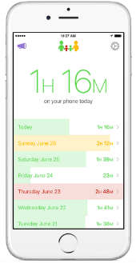
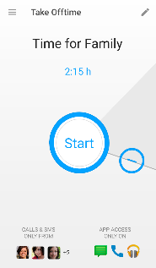
Dealing with tech
Controlling behaviour → self-regulating behaviour
    High powered vs low powered work

Slide 14
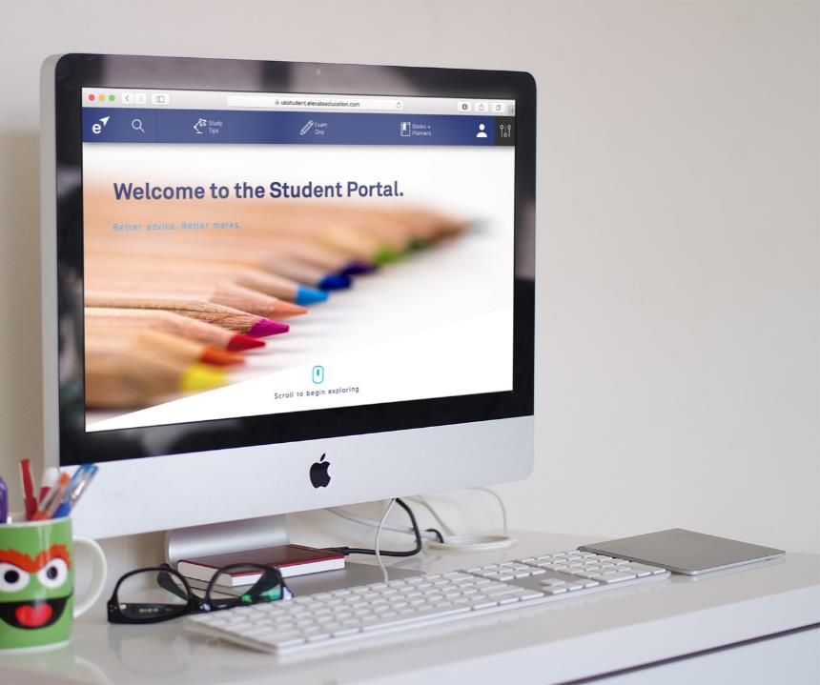
rondo

Slide 15
Next steps you can take

Slide 16
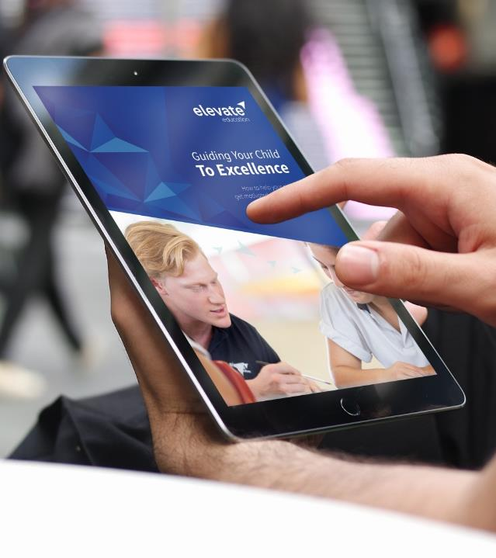
Upcoming Student Seminars

Slide 17
Parent
Guidebook

Slide 18
Private Student Coaching

Slide 19
Register here
Point Phone Camera👇🏼
tiny.cc/UKelevate

