Slide 1
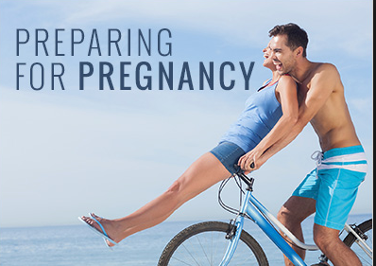
Pre-conception health
Consideration of health, fitness and lifestyle before trying for a baby, to improve chances of becoming pregnant and to give the baby a good start

Slide 2
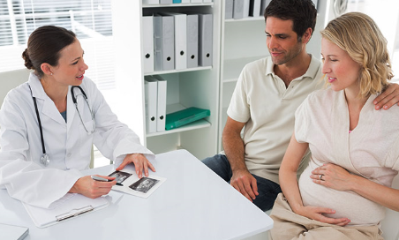
Genetic counselling
Expert health advice and guidance regarding the likelihood of an inherited disorder being passed on to a child by their parents

Slide 3

Contraception
This is the deliberate prevention of pregnancy

Slide 4
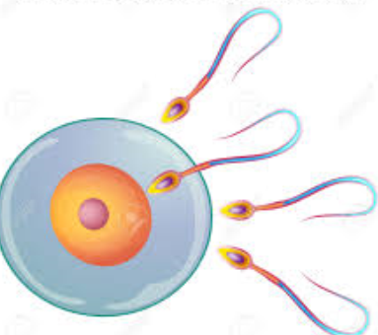
Conception
This occurs when the egg is fertilised by the sperm

Slide 5
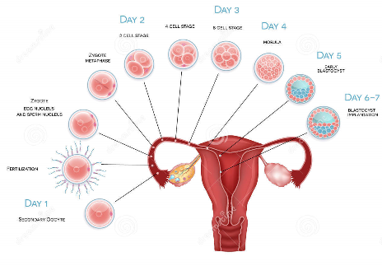
Implantation
This occurs when the fertilised egg becomes embedded in the wall of the uterus, about 6 days after conception

Slide 6
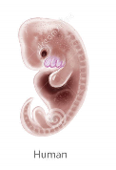
Embryo
The fertilised egg divides to form a ball of cells called the embryo

Slide 7
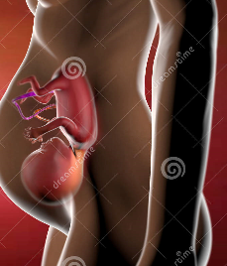
Foetus
From 8 weeks after fertilisation until birth the embryo is called a foetus. (‘Foetus’ is Latin for ‘young one’)

Slide 8

Role model
Someone a child looks up to and whose behaviour they imitate

Slide 9
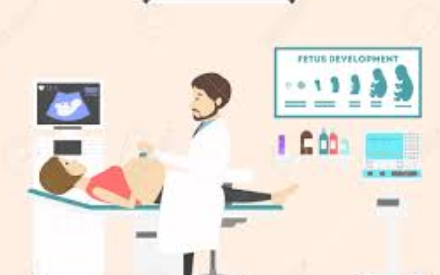
Antenatal
The care given to a woman throughout her pregnancy

Slide 10
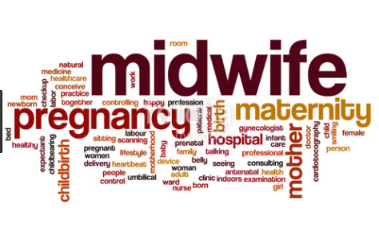
Midwife
A nurse who is specially trained in pregnancy and birth. Looks after the mother and baby for 10 days after the birth

Slide 11
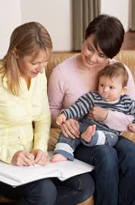
Health Visitor
A community based nurse who works with mothers and children up to 5 years old

Slide 12
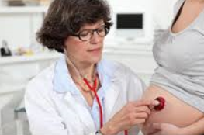
Obstetrician
A doctor who specialises in the care of pregnant women; looks after complications in pregnancy. Will carry out caesarean section or forceps deliveries

Slide 13
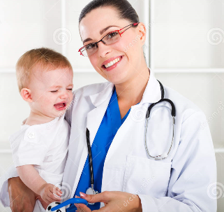
Paediatrician
A specialist doctor in the care of children up to 16 years. Will attend difficult births, in case the baby needs resuscitation

Slide 14
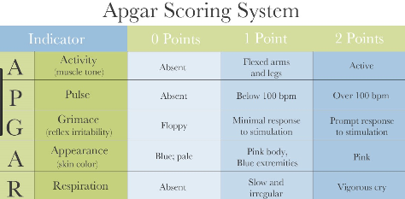
APGAR score
Five vital signs used to assess the health of a new-born baby. Appearance, Pulse, Grimace, Activity, Respiration

Slide 15
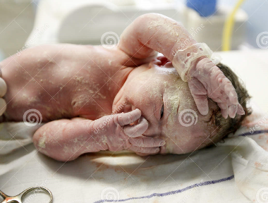
Vernix
This may be present at birth. It is a white, greasy substance that covers the baby’s skin

Slide 16
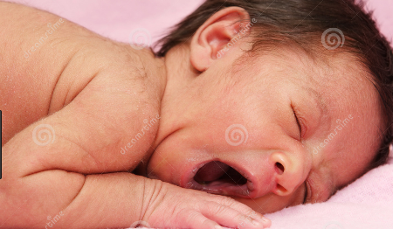
Lanugo
Found on the skin of babies who arrive early. It is a fine layer of hair that usually disappears before the birth

Slide 17
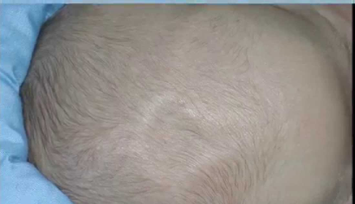
Fontanelle
This is the soft spot found on top of the baby’s head

Slide 18
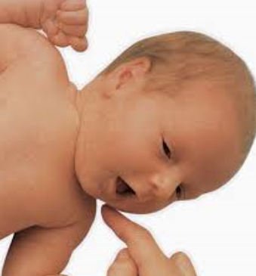
Reflexes
These are automatic actions that occur naturally without thinking

Slide 19
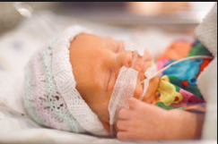
Premature (pre-term)
A baby who is born before 37 weeks

Slide 20
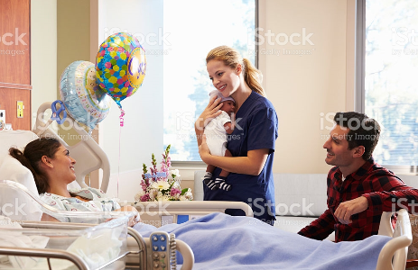
Post-natal
Post means ‘after’ and natal means ‘birth’. So this term refers to the first few weeks after the birth

Slide 21
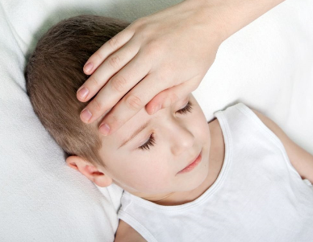
Signs of illness
Changes that occur when a child is becoming ill, for example loss of appetite, becoming ‘clingy’, crying, lethargic

Slide 22
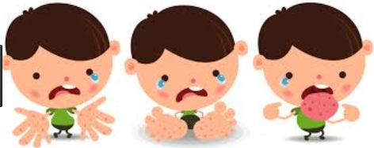
Symptoms of illness
Conditions such as: vomiting, diarrhoea, high temperature, breathing difficulties, fitting, developing a rash, unresponsive

Slide 23
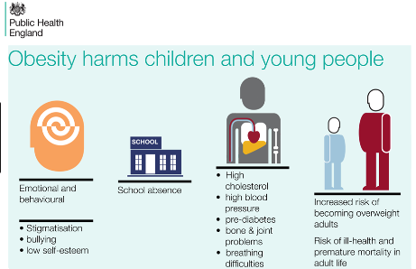
Obesity
A state of being seriously overweight

Slide 24
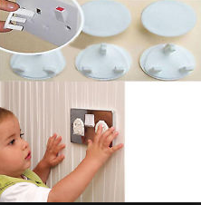
Safety strategies
Ways of reducing the risk or likelihood of danger. For example, having plug socket covers so children cannot poke things into the socket; fitting a stair gate; parents talking to a child about ‘stranger danger’

Slide 25

Hazard
This is something that could cause harm. For example, toys left on stairs are a trip hazard

Slide 26

BSI safety mark
The item has been tested by the British Standards Institution and has been found to be safe

Slide 27

CE symbol
A European symbol showing conformity with safety standards. Found on toys

